Slide 1
寫 心 經
Writing the Heart Sutra
A guidebook for learners

Slide 2
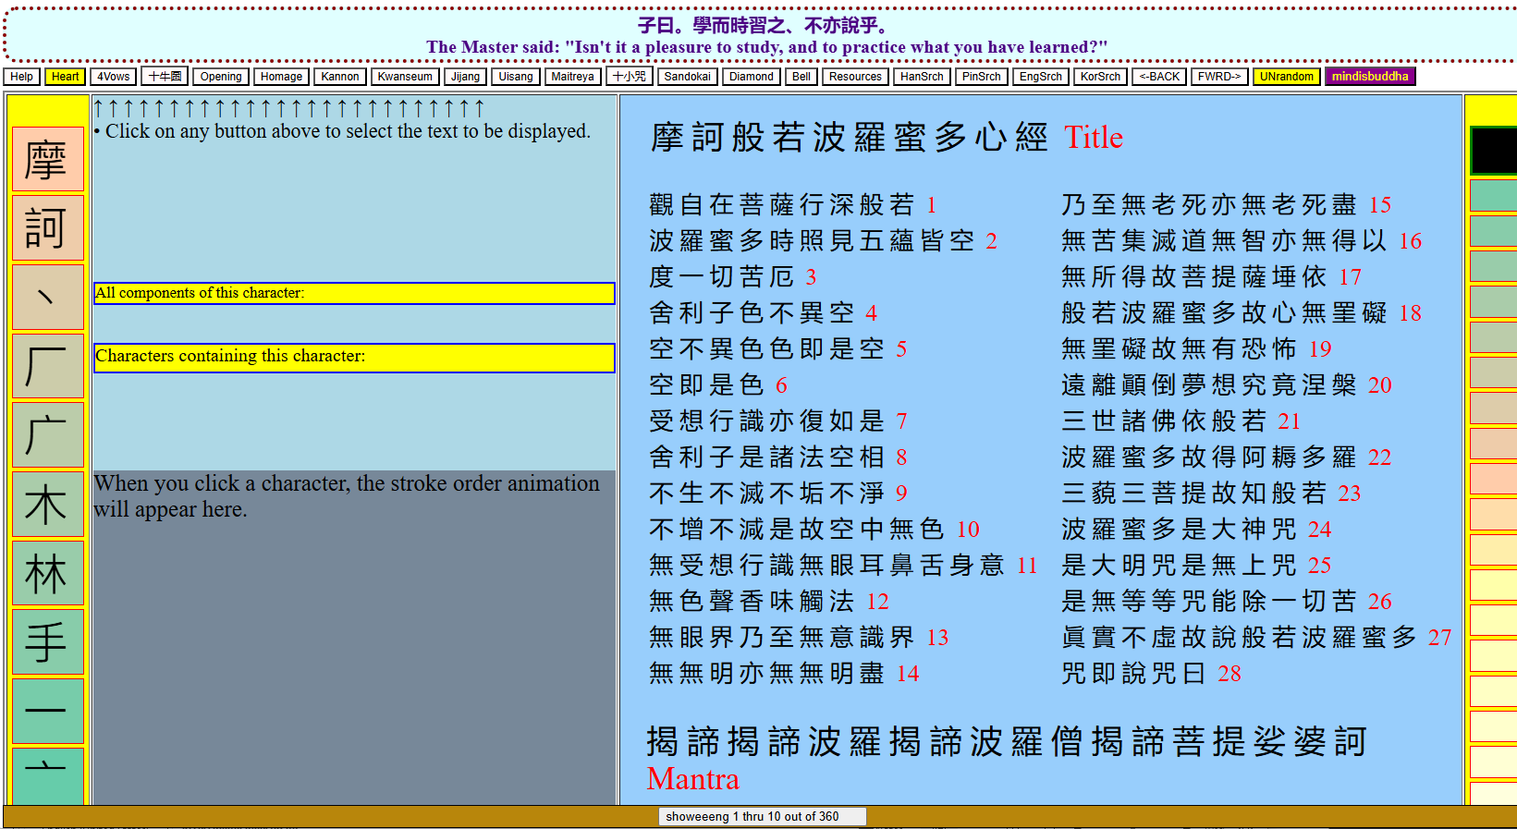
A Little Guide Book for learning how to write the Heart Sutra
For more details see the supplement here: https://mindisbuddha.org/sashimgyeong
The following pages are for anyone wanting to learn how to write the Heart Sutra. Pages 5-9 show the entire Heart Sutra written out in characters you can trace over. Then on pages 11-19 each line for tracing is followed by a blank line for copying the characters.
Finally, there are five blank pages (20-24) for you to write the whole Heart Sutra yourself “from scratch.”
In order to write the characters correctly you need to know the individual “strokes” that make up each character, including the direction each stroke, and the order in which they are written.
Check out the following website to see examples of “stroke order animations” that will help you: https://www.mindisbuddha.org/writingtheox/
A supplement with more details, including stroke order animations, is available here: https://mindisbuddha.org/sashimgyeong

Slide 3
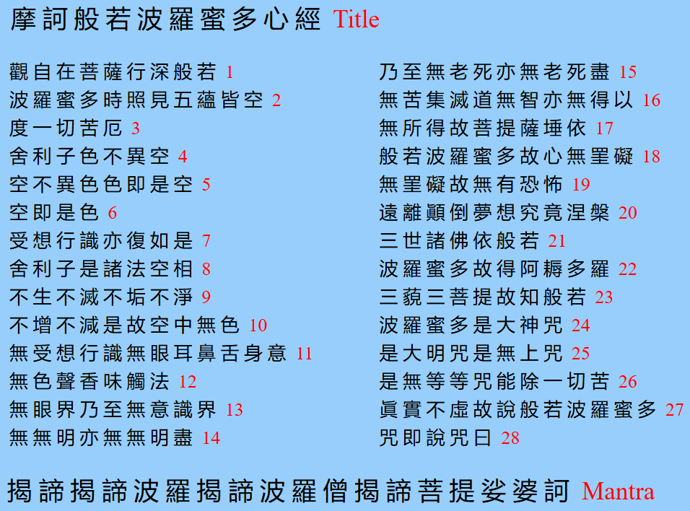
There are a total of 270 Hanja (characters) in the Heart Sutra. Ten of these Hanja are in the title.
This 270 character version of the Heart Sutra is the one composed by Master Xuanzang in 645 AD, upon his return to China from India.
For 1400 years, Buddhists have been reciting this 270 character version of the Heart Sutra, as well as writing it out as a practice known as Sa Shim Gyeong (寫心經), literally, “Writing the Heart Sutra”.
The line numbering shown here is somewhat arbitrary. It is based on the way that Zen Master Seung Sahn wrote the syllables out when he taught his Western students to chant the Heart Sutra.

Slide 4
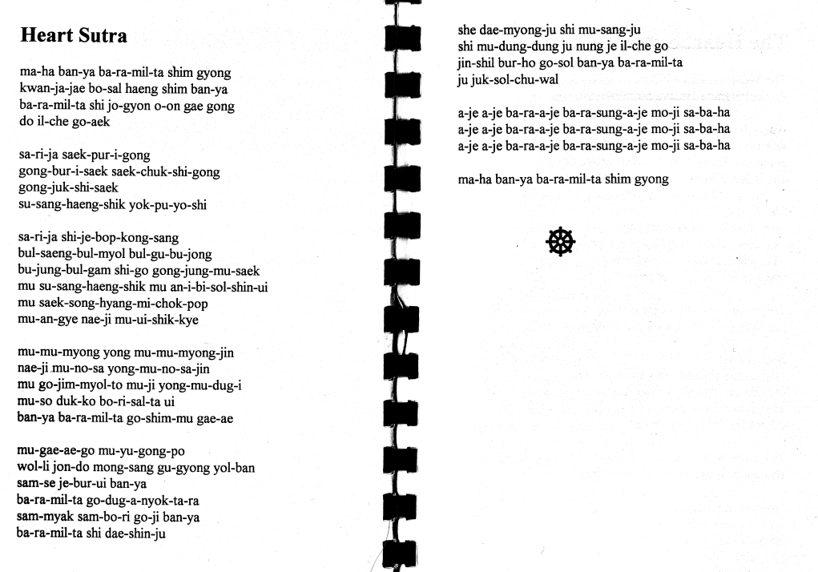
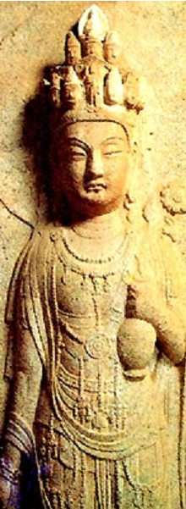
25
26
27
28
Title
1
2
3
4
5
6
7
8
9
10
11
12
13
14
15
16
17
18
19
20
21
22
23
24
mantra
Title
A typical example of the “Korean” Heart Sutra spelled out phonetically for English speakers.
Line numbers have been added in red.
Note that what is being chanted is not Korean. It is the Chinese version of the Heart Sutra from Master Xuanzang, but with a Korean pronunciation for each character. This is called “Sino-Korean”.

Slide 5
ma-ha ban-ya ba-ra-mil-ta shim gyong // The Maha Prajna Paramita Hridaya Sutra Title
kwan-ja-jae bo-sal haeng shim ban-ya // Avalokitesvara Bodhisattva while practicing deeply the Prajna 1
ba-ra mil-ta shi jo-gyon o-on gae gong // Paramita, perceives that all five skandhas are empty 2
do il-che go-aek // and is saved from all suffering and distress. 3
sa-ri-ja saek-pur-i-gong // Shariputra, form does not differ from emptiness 4
gong-bur-i-saek saek-chuk-shi-gong // emptiness does not differ from form. That which is form is emptiness 5
摩 訶 般 若 波 羅 蜜 多 心 經
T
i
t
l
e
觀 自 在 菩 薩 行 深 般 若
1
波 羅 蜜 多 時 照 見 五 蘊 皆 空
2
度 一 切 苦 厄
3
舍 利 子 色 不 異 空
4
空 不 異 色 色 即 是 空
5

Slide 6
gong-juk-shi-saek // that which is emptiness form. 6
su-sang-haeng-shik yok-pu-yo-shi // The same is true of feelings, perceptions, impulses, consciousness. 7
sa-ri-ja shi-je-bop-kong-sang // Shariputra, all dharmas are marked with emptiness 8
bul-saeng-bul-myol bul-gu-bu-jong // they do not appear or disappear, are not tainted or pure 9
bu-jung-bul-gam shi-go gong-jung-mu-saek // do not increase or decrease. Therefore in emptiness no form 10
mu su-sang-haeng-shik mu an-i-bi-sol-shin-ui // no feelings, perceptions, impulses, consciousness. No eyes, ears, nose, tongue, body, mind; 11
空 即 是 色
受 想 行 識 亦 復 如 是
舍 利 子 是 諸 法 空 相
不 生 不 滅 不 垢 不 淨
不 增 不 減 是 故 空 中 無 色
無 受 想 行 識 無 眼 耳 鼻 舌 身 意
6
7
8
9
10
11

Slide 7
mu saek-song-hyang-mi-chok-pop // no color, no sound, no smell, no taste, no touch, no object of mind; 12
mu-an-gye nae-ji mu-ui-shik-kye // no realm of eyes and so forth until no realm of mind consciousness. 13
mu-mu-myong yong mu-mu-myong-jin // No ignorance and also no extinction of it 14
nae-ji mu-no-sa yong-mu-no-sa-jin // and so forth until no old age and death and also no extinction of them 15
mu go-jim-myol-to mu-ji yong-mu-dug-i // No suffering, no origination, no stopping, no path, no cognition, also no attainment 16
mu-so duk-ko bo-ri-sal-ta ui // with nothing to attain. The Bodhisattva depends on 17
無 色 聲 香 味 觸 法
無 眼 界 乃 至 無 意 識 界
無 無 明 亦 無 無 明 盡
乃 至 無 老 死 亦 無 老 死 盡
無 苦 集 滅 道 無 智 亦 無 得 以
無 所 得 故 菩 提 薩 捶 依
12
13
14
15
16
17

Slide 8
ban-ya ba-ra-mil-ta go-shim-mu gae-ae // Prajna Paramita and the mind is no hindrance; 18
mu-gae-ae-go mu-yu-gong-po // without any hindrance no fears exist. 19
wol-li jon-do mong-sang gu-gyong yol-ban // Far apart from every perverted view one dwells in 20
sam se je bur ui ban ya // nirvana, in the three worlds all Buddhas rely on Prajna 21
ba-ra-mil-ta go-dug-a-nyok-ta-ra // Paramita and attain Anuttara 22
sam-myak sam-bo-ri go-ji ban-ya // Samyak Sambodhi. Therefore know that Prajna 23
般 若 波 羅 蜜 多 故 心 無 罣 礙
無 罣 礙 故 無 有 恐 怖
遠 離 顚 倒 夢 想 究 竟 涅 槃
三 世 諸 佛 依 般 若
波 羅 蜜 多 故 得 阿 耨 多 羅
三 藐 三 菩 提 故 知 般 若
18
19
20
21
22
23

Slide 9
ba-ra-mil-ta shi dae-shin ju // Paramita is the great transcendent mantra, 24
shi dae-myong-ju shi mu-sang-ju // is the great bright mantra, is the utmost mantra, 25
shi mu-dung-dung ju nung je il-che go // is the supreme mantra which is able to relieve all suffering 26
jin-shil bur-ho go-sol ban-ya ba-ra-mil-ta // and is true, not false. So proclaim the Prajna Paramita 27
ju juk-sol-chu-wal // mantra, proclaim the mantra which says: 28
a-je a-je ba-ra-a-je ba-ra-sung-a-je mo-ji sa-ba-ha Mantra
波 羅 蜜 多 是 大 神 咒
24
是 大 明 咒 是 無 上 咒
是 無 等 等 咒 能 除 一 切 苦
25
26
眞 實 不 虚 故 說 般 若 波 羅 蜜 多
27
咒 即 說 咒 曰 揭 諦 揭 諦 波 羅
28
m
a
n
t
r
a
揭 諦 波 羅 僧 揭 諦 菩 提 娑 婆 訶

Slide 10
ma-ha ban-ya ba-ra-mil-ta shim gyong // The Maha Prajna Paramita Hridaya Sutra Title
kwan-ja-jae bo-sal haeng shim ban-ya // Avalokitesvara Bodhisattva while practicing deeply the Prajna 1
ba-ra mil-ta shi jo-gyon o-on gae gong // Paramita, perceives that all five skandhas are empty 2
摩 訶 般 若 波 羅 蜜 多 心 經
T
i
t
l
e
觀 自 在 菩 薩 行 深 般 若
1
波 羅 蜜 多 時 照 見 五 蘊 皆 空
2

Slide 11
do il-che go-aek // and is saved from all suffering and distress. 3
sa-ri-ja saek-pur-i-gong // Shariputra, form does not differ from emptiness 4
gong-bur-i-saek saek-chuk-shi-gong // emptiness does not differ from form. That which is form is emptiness 5
度 一 切 苦 厄
3
舍 利 子 色 不 異 空
4
空 不 異 色 色 即 是 空
5

Slide 12
gong-juk-shi-saek // that which is emptiness form. 6
su-sang-haeng-shik yok-pu-yo-shi // The same is true of feelings, perceptions, impulses, consciousness. 7
sa-ri-ja shi-je-bop-kong-sang // Shariputra, all dharmas are marked with emptiness 8
空 即 是 色
受 想 行 識 亦 復 如 是
舍 利 子 是 諸 法 空 相
6
7
8

Slide 13
bul-saeng-bul-myol bul-gu-bu-jong // they do not appear or disappear, are not tainted or pure 9
bu-jung-bul-gam shi-go gong-jung-mu-saek // do not increase or decrease. Therefore in emptiness no form 10
mu su-sang-haeng-shik mu an-i-bi-sol-shin-ui // no feelings, perceptions, impulses, consciousness. No eyes, ears, nose, tongue, body, mind; 11
不 生 不 滅 不 垢 不 淨
不 增 不 減 是 故 空 中 無 色
無 受 想 行 識 無 眼 耳 鼻 舌 身 意
9
10
11

Slide 14
mu saek-song-hyang-mi-chok-pop // no color, no sound, no smell, no taste, no touch, no object of mind; 12
mu-an-gye nae-ji mu-ui-shik-kye // no realm of eyes and so forth until no realm of mind consciousness. 13
mu-mu-myong yong mu-mu-myong-jin // No ignorance and also no extinction of it 14
無 色 聲 香 味 觸 法
無 眼 界 乃 至 無 意 識 界
無 無 明 亦 無 無 明 盡
12
13
14

Slide 15
nae-ji mu-no-sa yong-mu-no-sa-jin // and so forth until no old age and death and also no extinction of them 15
mu go-jim-myol-to mu-ji yong-mu-dug-i // No suffering, no origination, no stopping, no path, no cognition, also no attainment 16
mu-so duk-ko bo-ri-sal-ta ui // with nothing to attain. The Bodhisattva depends on 17
乃 至 無 老 死 亦 無 老 死 盡
無 苦 集 滅 道 無 智 亦 無 得 以
無 所 得 故 菩 提 薩 捶 依
15
16
17

Slide 16
ban-ya ba-ra-mil-ta go-shim-mu gae-ae // Prajna Paramita and the mind is no hindrance; 18
mu-gae-ae-go mu-yu-gong-po // without any hindrance no fears exist. 19
wol-li jon-do mong-sang gu-gyong yol-ban // Far apart from every perverted view one dwells in 20
般 若 波 羅 蜜 多 故 心 無 罣 礙
無 罣 礙 故 無 有 恐 怖
遠 離 顚 倒 夢 想 究 竟 涅 槃
18
19
20

Slide 17
sam se je bur ui ban ya // nirvana, in the three worlds all Buddhas rely on Prajna 21
ba-ra-mil-ta go-dug-a-nyok-ta-ra // Paramita and attain Anuttara 22
sam-myak sam-bo-ri go-ji ban-ya // Samyak Sambodhi. Therefore know that Prajna 23
三 世 諸 佛 依 般 若
波 羅 蜜 多 故 得 阿 耨 多 羅
三 藐 三 菩 提 故 知 般 若
21
22
23

Slide 18
ba-ra-mil-ta shi dae-shin ju // Paramita is the great transcendent mantra, 24
shi dae-myong-ju shi mu-sang-ju // is the great bright mantra, is the utmost mantra, 25
shi mu-dung-dung ju nung je il-che go // is the supreme mantra which is able to relieve all suffering 26
波 羅 蜜 多 是 大 神 咒
24
是 大 明 咒 是 無 上 咒
25
是 無 等 等 咒 能 除 一 切 苦
26

Slide 19
jin-shil bur-ho go-sol ban-ya ba-ra-mil-ta // and is true, not false. So proclaim the Prajna Paramita 27
ju juk-sol-chu-wal // mantra, proclaim the mantra which says: 28
a-je a-je ba-ra-a-je ba-ra-sung-a-je mo-ji sa-ba-ha Mantra
眞 實 不 虚 故 說 般 若 波 羅 蜜 多
27
咒 即 說 咒 曰 揭 諦 揭 諦 波 羅
28
m
a
n
t
r
a
揭 諦 波 羅 僧 揭 諦 菩 提 娑 婆 訶
m
a
n
t
r
a

Slide 20
Blank Hanja grid

Slide 21
Blank Hanja grid

Slide 22
Blank Hanja grid

Slide 23
Blank Hanja grid

Slide 24
Blank Hanja grid

