Slide 1
HS.28 (The Heart Sutra)
What is the Heart Sutra the Heart of?
This is the third class on the Heart Sutra.
The first class looked very broadly at "What is the Heart Sutra?"
The second class looked at the Heart Sutra Mantra.
This class asks: What is Prajna Paramita? That is, what is the Heart Sutra the Heart of?
"Prajna Paramita" means at least four different things:
1. The sixth Paramita: wisdom
2. A subgenre of Buddhist texts called the Prajna Paramita Sutras
3. A bodhisattva named "Prajna Paramita", who is "The Mother of All the Buddhas"
4. The Heart Sutra mantra is itself referred to as "Prajna Paramita"

Slide 2
HS.29 (The Heart Sutra)
What are the Paramitas?
The path to Buddhahood is nothing other than the practice of the Paramitas (or Paramis in Pali). This is the case for both Mahayana and non-Mahayana Buddhists.
The Jataka Tales are all about how the Bodhisattva (who would eventually be born as Siddhartha and become Shakyamuni Buddha) practiced and perfected the 10 Paramitas/Paramis over the course of hundreds of lifetimes.
Theravada Mahayana
Dāna pāramī: generosity, giving of oneself
Sīla pāramī: virtue, morality, proper conduct
Nekkhamma pāramī: renunciation
Paññā pāramī: wisdom, discernment
Viriya pāramī: energy, diligence, vigour, effort
Khanti pāramī: patience, tolerance, forbearance
Sacca pāramī: truthfulness, honesty
Adhiṭṭhāna pāramī: determination, resolution
Mettā pāramī: goodwill, friendliness, loving-kindness
Upekkhā pāramī: equanimity, serenity
Dāna pāramitā
Śīla pāramitā
Kṣānti pāramitāpatience, tolerance, forbearance
Vīrya paramita: energy, diligence, vigour, effort
Dhyāna paramita: concentration, contemplation
Prajñā paramita: wisdom, insight
Upāya paramita: skillful means
Praṇidhāna pāramitā: vow, resolution, aspiration,
Bala paramita: spiritual power
Jñāna paramita: knowledge

Slide 3
HS.30 (The Heart Sutra)
https://www.dalailama.com/news/2021/concerning-the-heart-of-wisdom
Concerning the ‘Heart of Wisdom’ May 1, 2021 virtual teaching by the Dalai Lama
[The Buddha] taught that suffering is to be known and yet there is nothing to be known. Though its origin must be overcome, there is nothing to overcome. While cessation must be achieved, there is nothing to be achieved and despite the need to cultivate the path, there is nothing to be cultivated. He clarified that suffering, origin, cessation and path have no independent existence.
https://www.readingistherapy.com/dalai-lama-emptiness-phenomenon/
The Dalai Lama on the Emptiness of Phenomenon [Excerpted from An Open Heart: Practicing Compassion in Everyday Life by the Dalai Lama.]
Ultimately, all our difficulties arise from one basic illusion. We believe in the inherent existence of ourselves and all other phenomena. We project, and then cling to, an idea of the intrinsic nature of things, an essence that phenomena do not actually possess. Let us take a simple chair as an example. We believe, without fully recognizing this belief, that there is such a thing as an essential chair-ness, a quality of a chair that seems to exist among its parts: the legs, seat, and back. In the same way, we each believe there to be an essential and continuous "me" pervading the physical and mental parts that make up each of us. This essential quality is merely imputed by us; it does not actually exist.
Our grasping at this inherent existence is a fundamentally mistaken perception that we must eliminate through meditation practices of the wisdom path. Why? Because it is the root cause of all our misery. It lies at the core of all our afflictive emotions.

Slide 4
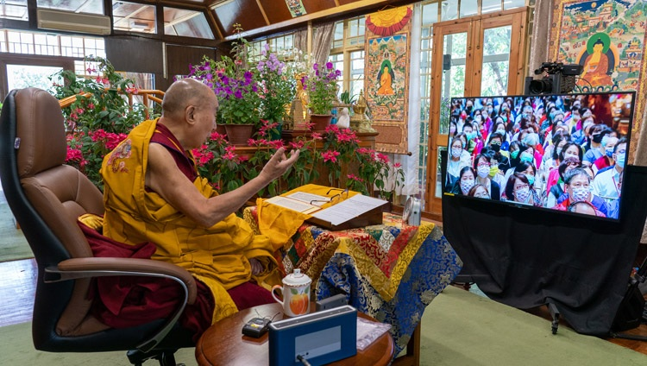
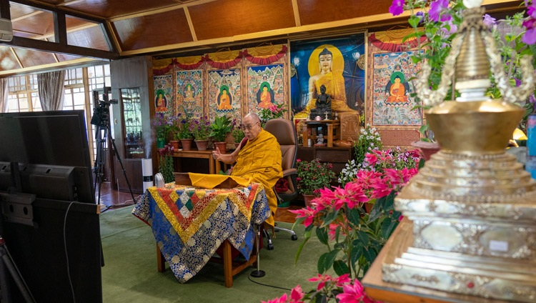
HS.31 (The Heart Sutra)
We can abandon this illusion of an essential quality only by cultivating its direct antidote, which is the wisdom that realizes the nonexistence of that quality. Again, we cultivate this profound wisdom, as we cultivate humility, in order to uproot our pride. We must first become familiar with the improper way we perceive ourselves and other phenomena; we can then cultivate a correct perception of phenomena. Initially this perception will be intellectual, as is the kinds of understanding one achieves through study or listening to teachings. To deepen this perception requires … more sustained meditation practice …. Only then is the perception able to truly affect our view of ourselves and other things. By directly realizing our lack of an inherent nature, we uproot the very basis of the self-grasping that lies at the core of all our suffering.
Developing wisdom is a process of bringing our minds into accordance with the way things really are. Through this process we gradually remove the incorrect perceptions or reality we have had since beginingless time. This is not easy. Merely understanding what is meant by the inherent or intrinsic existence of things demands much study and contemplation. Recognizing that things have no inherent existence is a profound insight, requiring years of study and meditation.

Slide 5
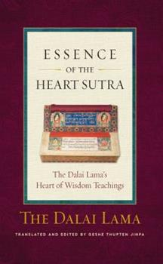
HS.32 (The Heart Sutra)
According to Buddhism, compassion is an aspiration, a state of mind, wanting others to be free from suffering. It’s not passive—it’s not empathy alone—but rather an empathetic altruism that actively strives to free others from suffering. Genuine compassion must have both wisdom and lovingkindness. That is to say, one must understand the nature of the suffering from which we wish to free others (this is wisdom), and one must experience deep intimacy and empathy with other sentient beings (this is lovingkindness). [p. 49]
If we are to cultivate the deepest wisdom, we must understand suffering at its deepest, most pervasive level. In turn, freedom from that level of suffering is true nirvana, true liberation, the true state of cessation. Freedom from the first level of suffering alone—merely being free of unpleasant physical and psychological experiences—is not true cessation of suffering. Freedom from the second level is again not true cessation. However, freedom from the third level of suffering—being completely free from the very source of suffering—that is genuine cessation, genuine liberation. [p. 51]
From: Essence of the Heart Sutra: The Dalai Lama's Heart of Wisdom Teachings, Wisdom Publications
https://wisdomexperience.org/product/essence-heart-sutra/

Slide 6
HS.33 (The Heart Sutra)
Sunyata (from Barbara O'Brien's "Circle of the Way")
Sunyata (also spelled shunyata), or “emptiness,” is a major theme in the prajnaparamita sutras, and it is often called the most misunderstood word in Buddhism. All phenomena are “empty,” the teaching says. What they are empty of is self-essence. To a point, this is not a radically different teaching from earlier [non-Mahayana] ones. Consider the chariot simile. If we disassemble Menander’s chariot piece by piece and lay the parts in a pile one at a time, at precisely what point does it cease to be a chariot? If we’re being honest, we must admit that this is a subjective judgment. Some might say at the point it is no longer drivable. Others might say that the eventual pile of wood and iron is still a chariot, just a disassembled one. This ought to tell us that “chariot” is a concept, not an essence that resides in the physical parts of the thing we call “chariot.” Likewise, beings have no permanent essence of self that resides in their bodies. Theravada Buddhism does not disagree…..
Mahayana scholars developed their teachings on emptiness from another doctrine, called dependent origination or dependent arising (in Sanskrit, pratityasamutpada). This early teaching says that all phenomena are caused to come into existence by other phenomena….
In the Pali canon, dependent origination describes how an individual creates suffering and remains stuck in the cycle of samsara. But from the Buddha’s teaching on dependent origination, Mahayana developed a doctrine of the interexistence of all phenomena—nothing exists separately and independently from everything else. And, it was reasoned, a thing that has no independent existence cannot be said to exist in and of itself….
We distinguish all phenomena by their relationship to other phenomena. They do not exist of themselves. However, it’s also nonsensical nonsensical to say phenomena don’t exist, because, um, there they are…..

Slide 7
HS.34 (The Heart Sutra)
The Two Truths (from Barbara O'Brien's "Circle of the Way")
From this question of existence and nonexistence nonexistence came the doctrine of the two truths, which says that reality is both absolute and relative. In a relative sense, there are toasters and toast, dogs and cats, people and petunias. In an absolute sense, nothing is distinguished; there is just boundlessness. All phenomena are expressions of that boundlessness. It’s important to understand that both absolute and relative are true. Dharma students sometimes fall into the habit of thinking of relative reality as being false and absolute as true. But in Zen at least, it’s understood that both absolute and relative are true and indivisible. One cannot be without the other. Together, absolute and relative make up the whole of reality.
Suchness
Suchness (in Sanskrit, tathata), or sometimes thusness, is a word that appears in the Pali canon and is used by Theravadins. In both Theravada and Mahayana Buddhism, it is understood that the true nature of reality is ineffable, beyond description and conceptualization. Suchness is a deliberately vague term to keep us from conceptualizing it.
In Mahayana, suchness is identified with emptiness and with absolute and relative reality. The Lotus Sutra (composed in probably the second or third century C.E.) developed suchness further into a list of ten “suchnesses,” or aspects of suchness. In brief, the suchness of a thing takes in its form, its function, and all of its causal relationships. The tenth factor contains all the aspects coalescing into a seamless whole. For example, the suchness of a single sunflower takes in the sprout, the sun, the soil, the rain, the finch feasting on its seeds. It takes in all the sunflowers that came before and all that come after and all interconnecting phenomena. It takes in the entire cosmos throughout space and time, which is present in the sunflower.

Slide 8
HS.35 (The Heart Sutra)
2. Sutras
Mahayana Buddhism is the "Second Turning of the Wheel of the Dharma".
Traditionally it is taught that the Mahayana teachings were given by the Buddha later in his life, but that these teachings were neglected and eventually forgotten after the Buddha's Parinirvana. Then these teachings were rediscovered when Nagarjuna visited the realm of the Nagas. The first teachings that Nagarjuna retrieved from the Nagas were the Prajna Paramita Sutras. Some say that the Nagas grew to be obsessed with Nagarjuna, so that they would only give him a few of the Sutras at a time, forcing him to return over and over again to the Naga realm.
Many modern Buddhist scholars (and others with limited imaginations) insist that the Mahayana Sutras could not possibly have been taught by the Buddha (because, you know, Nagas don't really exist), and that they therefore must have been written much later (by people who were not Shakyamuni Buddha, but who claimed to be).
Regardless of their origin, it is generally accepted that the Prajna Paramita Sutras were the first Mahayana Sutras to appear on the scene.

Slide 9
HS.36 (The Heart Sutra)
Zen Master Seung Sahn, from "The Compass of Zen":
Buddhism is just a name for the path of attaining our true selves and helping all other beings. But that is very difficult for many people. So the Buddha appeared in this world, got enlightenment, and taught us for forty-five years. First he taught Hinayana Buddhism. He taught the Four Noble Truths, that all life is impermanent, that therefore life is suffering, and how to get out of this suffering. He taught dependent origination and the practice of the various insights.
As his students' minds developed, he started to teach what came to be called Mahayana Buddhism. This is the path of emptiness. It is sometimes called the Great Bodhisattva Way. I vow not to enter the infinite stillness and bliss of nirvana until the last sentient being is released from suffering. And finally, when his students were completely ripe, he taught Zen. Twenty-five hundred monks assembled at the Vulture’s Peak to hear the Buddha give a dharma speech. But he did not open his mouth, and only sat there, not moving. Several minutes passed. His students gazed intently at the Buddha, wondering if something was wrong. "Maybe our teacher is sick today . . ." "When will the teaching begin?" Finally, he picked up a single flower and held it aloft. But nobody understood. Everybody looked around, still waiting for him to talk about Dharma, still wondering when he would start teaching. Only one student, Mahakashyapa, smiled broadly from the far back of the assembly — "Ahhhhh!" Then the Buddha said, “I transmit my true Dharma to you,” and gave Mahakashyapa transmission, making him the Buddha’s first successor in a lineage that continues to this day. It was a transmission without words and speech, a transmission directly from mind to mind. So the teaching style of Hinayana Buddhism, Mahayana Buddhism, and Zen are completely different. Their techniques are different. But the direction and purpose are the same: How can we wake up and help this world?

Slide 10
HS.37 (The Heart Sutra)
….. The Hinayana view calls this realm which we all inhabit a “suffering world.” All life is suffering, and suffering is life: samsara. Hinayana Buddhist teaching explains that we are living in this impermanent world, this suffering world, and it shows how we can get out of it. This suffering world is created entirely by our own thinking. Through this teaching we are shown how to go from this opposites world of life and death to attain the realm of the Absolute, or nirvana. In nirvana there is no life and no death; no coming or going; no up or down. It is a state of complete stillness and bliss. Attaining the completely void state of nirvana is the ultimate goal of Hinayana Buddhist teaching.
Mahayana Buddhist teaching begins at this point of emptiness and nonself, where Hinayana teaching leaves off. It shows how we can begin with the experience of emptiness to attain "complete world." This means that if your mind is complete, then everything is always complete, complete, complete. The sun, the moon, the stars — everything is complete. Suffering is complete. Happiness is also complete. What is not complete? A famous poem says, "One by one, each thing is complete. One by one, each thing has it." If you keep this mind [hits the table], that point has no inside or outside. It has no subject or object. [Hits.] You are the universe; the universe is you. We sometimes call that the Absolute. [Hits.] The Absolute means "complete."
This "complete world" means truth. When your mind has cut off all thinking, there is no thinking. No thinking means there is no I." When there is no "I," then your mind is clear like space, which means your mind is clear like a mirror. It only reflects all things that appear in front of it exactly as they are: the sky is blue, the tree is green, a dog is barking, "Woof! Woof!" Sugar is sweet. When you see, when you hear, when you smell, when you taste, when you touch—
everything, just like this, is truth. That is, we say, "complete world."

Slide 11
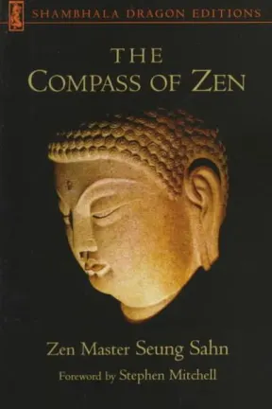
HS.38 (The Heart Sutra)
So attaining that this world is complete means completely attaining truth. However, the Buddha showed that we cannot stop here. True, everything is complete, just as it is; everything is truth. The sky is blue: that is truth. Sugar is sweet: that is truth. The wind is blowing through the trees outside right now: that is also truth. But we must take one more step: if you attain truth, then how do you make truth function correctly to make your life correct? Another way of saying it is, how do you help other sentient beings? Mahayana Buddhism means perceiving that all things are empty, and then from this fundamental experience of emptiness, attaining how this truth can help all beings, life after life. We sometimes call that Great Love and Great Compassion, or the Great Bodhisattva Way. From moment to moment my life is only for all beings.
Then what is Zen Buddhism? Zen never talks about absolutes, or the opposites world. It doesn’t try to explain emptiness, truth, or complete world. The practice of Zen never explains anything. Zen simply points directly at our mind, our true self, so that we can directly attain enlightenment and help all beings. So there is no emphasis placed on language or learning in Zen—there is simply the practice of meditation. Zen teaching never checks the opposites world, it never checks the Absolute, and it never talks about complete world. All Zen teaching simply points to your mind, just this moment. What are you doing now? Zen teaching always returns us to what we can call "moment world." This moment is very important. In one moment, there is everything. In moment, there is infinite time and infinite space. [Hits the table loudly with his stick.] In moment there is the true way, and truth, and correct life. [Hits the table loudly.] In moment! In this one moment, there is everything [hits], and in this moment there is nothing [hits again]. So if you attain moment, you directly attain everything. That is Zen Buddhism. There is no mind [hits], no Buddha [hits], no God [hits], nothing! [Hits.] But there is mind [hits], is Buddha [hits], is God [hits], is everything! Experiencing that is Zen Buddhism.
https://terebess.hu/zen/mesterek/Compass.pdf

Slide 12
HS.39 (The Heart Sutra)
Mahayana Buddhists all tend to agree that the First Turning of the Wheel emphasizes Arhatship as the end goal and No-Self as the central teaching. And then the Second Turning emphasizes Buddhahood as the ultimate goal with Emptiness as it's primary teaching. But what about the Third Turning?
As was seen in the Compass of Zen quote, different Mahayana schools usually claim that their own specific school represents the Third, Ultimate, Turning of the Wheel. This is so blatantly sectarian that it hardly deserves serious consideration. It's actually kind of embarrassing.
A more general view of the Three Turnings that does not center on sectarian differences between competing Mahahana schools goes like this:
1st Turning: One path, One teaching. The path to Arhatship. Teaching emphasizes No Self. Path to Buddhahood limited to very, very few individuals. Rejects Mahayana.
2nd Turning: Two paths, Two teachings. The path to Buddhahood and the teaching of Emptiness are simply added to the first turning (Arhatship, and No-Self), with the "Bodhisattva" path to Buddhahood promoted as clearly superior, and perhaps only suitable for a select few. "Hinayana" used as derogatory term as a lower teaching suitable for those of lesser capacity.
3rd Turning: One Path, Many Teachings. Embraces all Buddhist teachings as Upaya. The Ultimate Teaching is Buddha Nature, but No-Self and Emptiness are seen as necessary prerequisites to avoid attachment to Buddha Nature.
gg

Slide 13
HS.40 (The Heart Sutra)
A similar approach is to frame the three turnings in terms of:
1. No-Self
2. Emptiness
3. Buddha-Nature
But if Buddha-Nature is the ultimate, most "advanced" teaching, why not just dispense with the first two turnings?
Without a grounding in the teachings of no-self and emptiness, the teaching of universal buddha nature, by itself, could easily lead to a sense of complacency. It could even lead to greater attachment to the idea of a real, fixed, separate "self".
1st: your mind is tainted and needs to be purified
2nd: your mind is neither tainted nor pure
3rd: your mind is pure (and perfect and complete) just as it is
Without the first two turnings of the wheel, it would be easy to conclude that we don't need to practice!

Slide 14
HS.41 (The Heart Sutra)
Sunyata (from Barbara O'Brien's "Circle of the Way")
Sunyata (also spelled shunyata), or “emptiness,” is a major theme in the prajnaparamita sutras, and it is often called the most misunderstood word in Buddhism. All phenomena are “empty,” the teaching says. What they are empty of is self-essence. To a point, this is not a radically different teaching from earlier ones. Consider the chariot simile. If we disassemble Menander’s chariot piece by piece and lay the parts in a pile one at a time, at precisely what point does it cease to be a chariot? If we’re being honest, we must admit that this is a subjective judgment. Some might say at the point it is no longer drivable. Others might say that the eventual pile of wood and iron is still a chariot, just a disassembled one. This ought to tell us that “chariot” is a concept, not an essence that resides in the physical parts of the thing we call “chariot.” Likewise, beings have no permanent essence of self that resides in their bodies. Theravada Buddhism does not disagree…..
Mahayana scholars developed their teachings on emptiness from another doctrine, called dependent origination or dependent arising (in Sanskrit, pratityasamutpada). This early teaching says that all phenomena are caused to come into existence by other phenomena….
In the Pali canon, dependent origination describes how an individual creates suffering and remains stuck in the cycle of samsara. But from the Buddha’s teaching on dependent origination, Mahayana developed a doctrine of the interexistence of all phenomena—nothing exists separately and independently from everything else. And, it was reasoned, a thing that has no independent existence cannot be said to exist in and of itself….
We distinguish all phenomena by their relationship to other phenomena. They do not exist of themselves. However, it’s also nonsensical nonsensical to say phenomena don’t exist, because, um, there they are…..

Slide 15
HS.42 (The Heart Sutra)
The Two Truths (from Barbara O'Brien's "Circle of the Way")
From this question of existence and nonexistence nonexistence came the doctrine of the two truths, which says that reality is both absolute and relative. In a relative sense, there are toasters and toast, dogs and cats, people and petunias. In an absolute sense, nothing is distinguished; there is just boundlessness. All phenomena are expressions of that boundlessness. It’s important to understand that both absolute and relative are true. Dharma students sometimes fall into the habit of thinking of relative reality as being false and absolute as true. But in Zen at least, it’s understood that both absolute and relative are true and indivisible. One cannot be without the other. Together, absolute and relative make up the whole of reality.
Suchness
Suchness (in Sanskrit, tathata), or sometimes thusness, is a word that appears in the Pali canon and is used by Theravadins. In both Theravada and Mahayana Buddhism, it is understood that the true nature of reality is ineffable, beyond description and conceptualization. Suchness is a deliberately vague term to keep us from conceptualizing it.
In Mahayana, suchness is identified with emptiness and with absolute and relative reality. The Lotus Sutra (composed in probably the second or third century C.E.) developed suchness further into a list of ten “suchnesses,” or aspects of suchness. In brief, the suchness of a thing takes in its form, its function, and all of its causal relationships. The tenth factor contains all the aspects coalescing into a seamless whole. For example, the suchness of a single sunflower takes in the sprout, the sun, the soil, the rain, the finch feasting on its seeds. It takes in all the sunflowers that came before and all that come after and all interconnecting phenomena. It takes in the entire cosmos throughout space and time, which is present in the sunflower.

Slide 16
HS.43 (The Heart Sutra)
The Ten Suchnesses (From the Lotus Sutra, Chapter Two):
But stop, Shariputra, I will say no more. Why? Because what the Buddha has achieved is the rarest and most difficult-to-understand Law. The true entity of all phenomena can only be understood and shared between Buddhas. This reality consists of the
appearance (character)
nature (nature)
entity (substance)
power (potential)
influence (function)
inherent cause (cause)
relation (condition)
latent effect (result)
manifest effect (effect)
consistency from beginning to end (essential unity)
(translation by Burton Watson, and also Kubo and Yuyama)

Slide 17
HS.44 (The Heart Sutra)
King Milinda's Questions and the Chariot Simile: Summary of a Key Early Buddhist Text by Barbara O'Brien
The Milindapanha presents a dialogue between King Menander I (Milinda in Pali) and an enlightened Buddhist monk named Nagasena. Menander I was an Indo-Greek king thought to have ruled from about 160 to 130 BCE. He was a king of Bactria, an ancient kingdom that took in what is now Turkmenistan, Afghanistan, Uzbekistan, and Tajikistan, plus a small part of Pakistan. This is partly the same area that came to be the Buddhist kingdom of Gandhara….
One of the King's first questions is on the nature of the self and personal identity. Nagasena greeted the King by acknowledging that Nagasena was his name, but that "Nagasena" was only a designation; no permanent individual "Nagasena" could be found.
This amused the King. Who is it that wears robes and takes food? he asked. If there is no Nagasena, who earns merit or demerit? Who causes karma? If what you say is true, a man could kill you and there would be no murder. "Nagasena" would be nothing but a sound.
Nagasena asked the King how he had come to his hermitage, on foot or by horseback? I came in a chariot, the King said.
But what is a chariot? Nagasena asked. Is it the wheels, or the axles, or the reigns, or the frame, or the seat, or the draught pole? Is it a combination of those elements? Or is it found outside those elements?
The King answered no to each question. Then there is no chariot! Nagasena said.
Now the King acknowledged the designation "chariot" depended on these constituent parts, but that "chariot" itself is a concept, or a mere name.

Slide 18
HS.45 [almost the same as HS.12] (The Heart Sutra)
title
core, continued
The Maha Prajna Paramita Hrdaya Sutra
Avalokitesvara Bodhisattva
when practicing deeply the Prajna Paramita
perceives that all five skandhas are empty
and is saved from all suffering and distress.
Shariputra, form does not differ from emptiness,
emptiness does not differ from form.
That which is form is emptiness,
that which is emptiness form.
The same is true of feelings,
perceptions, impulses, consciousness.
Shariputra, all dharmas are marked with emptiness;
they do not appear or disappear,
are not tainted or pure,
do not increase or decrease.
Therefore, in emptiness no form, no feelings,
perceptions, impulses, consciousness.
No eyes, no ears, no nose, no tongue, no body, no mind;
no color, no sound, no smell, no taste, no touch,
no object of mind;
no realm of eyes
and so forth until no realm of mind consciousness.
No ignorance and also no extinction of it,
and so forth until no old age and death
and also no extinction of them.
No suffering, no origination,
no stopping, no path, no cognition,
also no attainment with nothing to attain.
The Bodhisattva depends on Prajna Paramita
and the mind is no hindrance;
without any hindrance no fears exist.
Far apart from every deluded view one dwells in Nirvana.
In the three worlds
all Buddhas depend on Prajna Paramita
and attain Anuttara Samyak Sambodhi.
Therefore, know that Prajna Paramita
is the great transcendent mantra,
is the great bright mantra,
is the utmost mantra,
is the supreme mantra,
which is able to relieve all suffering
and is true, not false.
So proclaim the Prajna Paramita mantra,
proclaim the mantra which says:
gate gate paragate parasamgate bodhi svaha
introduction
conclusion
core
mantra

Slide 19
HS.46 (The Heart Sutra)
Xuanzang, who translated the Heat Sutra in the form that we use, also translated many other Prajna Paramita Sutras (from Wikipedia):
Prajñāpāramitā sūtra in 100,000 verses
Prajñāpāramitā sūtra in 25,000 verses
Prajñāpāramitā sūtra in 18,000 verses
Prajñāpāramitā sutra in 8,000 verses
An abridged version of the Prajñāpāramitā sūtra in 8,000 verses
Devarājapravara prajñāpāramitā sūtra - a part of the Questions of Suvikrānta
Prajñāpāramitā sūtra in 700 verses
Nāgaśripa-priccha Prajñāpāramitā
The Diamond Sutra
Prajñāpāramitā sūtra in 150 verses
Ārya pañcapāramitānirdeśa nāma mahāyāna sūtra
The questions of Suvikrānta

Slide 20
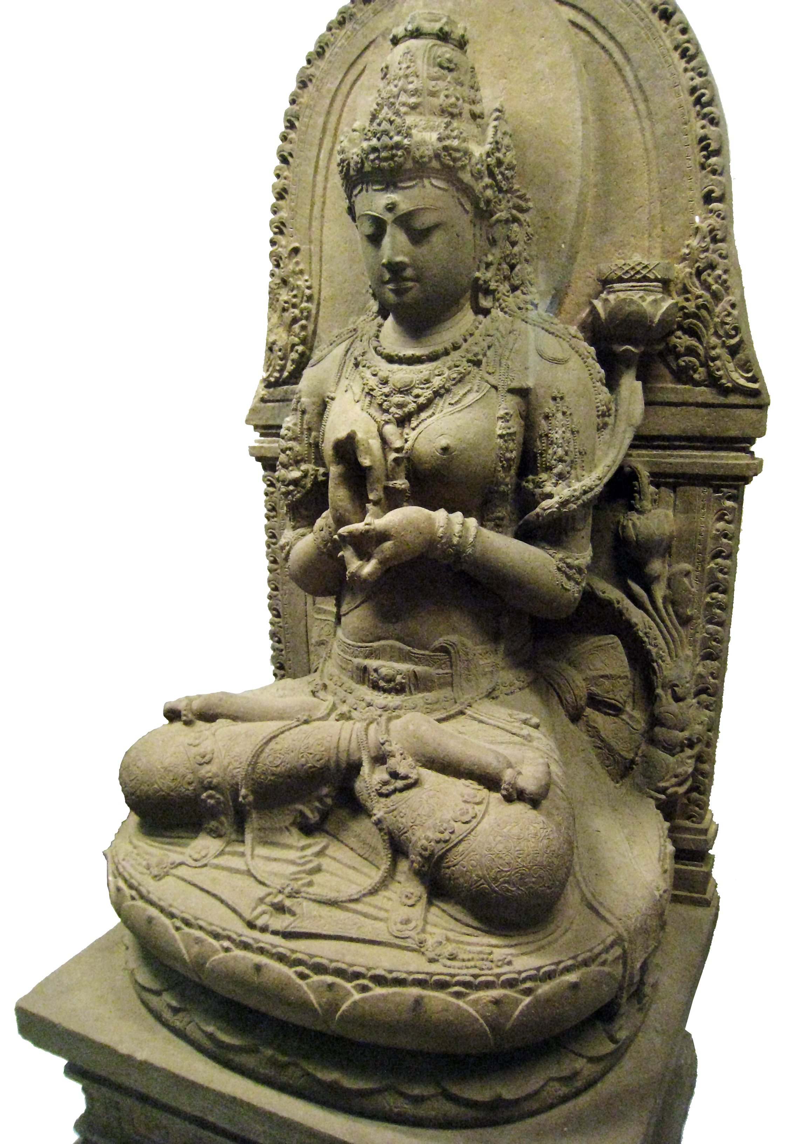
HS.47 (The Heart Sutra)
3. The Mother of All the Buddhas
[All quotes are from Chapter 8 of Miranda Shaw's Buddhist Goddesses of India]
She is the Perfect Wisdom that never comes into being
And therefore never goes out of being.
She is known as the Great Mother. ...
She is the Perfect Wisdom who gives birthless birth to all Buddhas.
And through these sublimely Awakened Ones,
It is Mother Prajnaparamita alone
Who turns the wheel of true teaching.
—8000-Line Perfect Wisdom Scripture
In the foundational body of Mahayana literature known as the Prajnaparamita or Perfection of Wisdom texts, the highest metaphysical principle— the energy, glory, and radiance of enlightened wisdom— is envisioned as a cosmic female, them other of knowledge, the source of all Buddhas. This goddess, known as Prajnaparamita is regarded as the
"mother" of all beings who attain enlightenment, for it is her wisdom that engenders liberation. She is the supreme teacher and eternal font of revelation. All who seek illumination must sit at her feet and drink from the stream of teachings that flow from her presence. Thus, Prajnaparamita is the ultimate source of refuge and object of reverence, for only those who prize wisdom above all else may attain it. Even Buddhas and bodhisattvas pay homage to her, because to her they owe their omniscience. To worship a Buddha, the relics of a Buddha, or a stupa is to honor what she has brought into being; to revere her is directly to worship the source.
Prajna paramita of Java

Slide 21
HS.48 (The Heart Sutra)
Prajnaparamita shares her name with the literature in which she appears, the philosophy with which she is associated, and the knowledge she personifies. The text that introduces both the philosophy and the goddess, the Aṣṭasāhasrikā Prajñāpāramitā Sūtra, or 8000-Line Perfect Wisdom Scripture, took shape during the first two centuries of the common era, although portions of the work evince earlier origins. In the traditional Buddhist view, this scripture is an abridgment of a much lengthier work revealed by Shakyamuni Buddha. Nonetheless, as the earliest known textual expression o f the philosophy, this volume m arks the historical emergence of Prajñāpāramitā. Although the work advances a systematic philosophical viewpoint, its language is redolent with poesy, devotion, and emotional fervor as it celebrates the goddess and her namesake wisdom.
The central importance and cosmic status o f the wisdom mother at her earliest appearance are surprising given the apparent swiftness with which she rose on the Mahayana horizon. Nothing in the female figures who preceded her would foreshadow such a development. Her female forebears were divinities associated with nature and its fecundating powers, such as tree spirits (yakshini), Prthivi, and Lakshmi. There is little in these goddesses of earthly provenance, however benevolent and auspicious they might be, to foretell the radiant entity of pure spirit and wisdom that is Prajñāpāramitā. Even Edward Conze’s suggestion that she represents the "irruption" into Buddhism of the Paleolithic and Dravidian mother goddess does not explain the sudden transformation o f the chthonic, fertile earth mother into the metaphysically sublime mother of wisdom. The goddess, like the philosophy with which she is associated, appears to represent a revolutionary shift in Buddhist consciousness.

Slide 22
HS.49 (The Heart Sutra)
Although Prajñāpāramitā, like her namesake wisdom, is said to transcend all categories and to be beyond form , she has the trait o f gender, and femaleness is central to her character. She hypostasizes the wisdom that is most often designated in this literature by the feminine noun prajna. Her femaleness, how­ever, has an internal logic that goes beyond mere linguistic coincidence. There are deep metaphorical resonances between motherhood and the matrix of wisdom and reality she represents. If gender is to be assigned to a generative principle, the feminine gender is a logical choice, for the womb is the most tangible source of generation in human experience. Just as male bodies derive biologically from female ones, it stands to follow in the religious sphere that male Buddhas would have a female source. Thus, the femaleness of Prajñāpāramitā carries the force of logic and observation.
One of the main titles and roles of Prajñāpāramitā is that of “Mother of All Buddhas” (sarva-buddha-mata, sarva-jina-m ata). This theme, one of the guiding principles o f the scripture, is introduced in an opening verse:
The Buddhas in the world-systems in the ten directions
Bring to mind this Perfection o f Wisdom as their mother.
The Saviours of the world who were in the past,
And also those that are now in the ten directions,
Have issued from her, and so will the future ones be.
She is the one who reveals reality,
She is the genetrix, the mother of the victorious ones.

Slide 23
HS.50 (The Heart Sutra)
The 8000-Line Perfect Wisdom Scripture emphasizes the theme that Buddhas cannot bring themselves into being but “owe their existence” to her. Thus, this philosophy accords primacy to the source— the metaphorical birth-giver— rather than to its fruits, extending the reassurance that even if a given Buddha and his teachings pass away, the mother abides and will birth more illumined children.
The text develops the metaphor of motherhood at length. Just as mothers extend com fort and safety to their children, Prajñāpāramitā is the “shelter, defence and protection” of the seeker of wisdom. Just as parents guide their children in morality, she is the source o f all virtues, or perfections of character. She nurtures her progeny by providing the knowledge they require to fulfill their highest destiny, namely, to understand the nature of reality and dedicate themselves to the welfare and liberation of all beings. Children naturally adore such a mother, seek to protect her from harm , and strive to bring her happiness:
"They would therefore look well after her, give her everything tha t can make her happy, protect her well, make much of her. . . . In just this same way . . . fond are the Tathagatas of this Perfection of Wisdom , so much do they cherish and protect it. For she is their mother and begetter, she showed them this all-knowledge, she instructed them in the ways of the world."
… [S]he is the teacher of teachers, the guide of the Buddhas and bodhisattvas as they lead others. She is the "inexhaustible storehouse" of truth that is given voice by all Buddhas of the past, present, and future. When Buddhas teach, Prajñāpāramitā is the source and content of their teachings. As the fount of all truth, it is she who sets in motion the wheel of Dharma. Thus, a Buddha may teach for the duration of a single lifetime, or even in myriad worlds and aeons, but the teachings of mother Prajñāpāramitā flow for all eternity. Because she is eternal, the Buddhas and bodhisattvas will always have guidance and assistance.

Slide 24
HS.51 (The Heart Sutra)
4. Mantra [more quotes from Miranda Shaw's book]
Prajñāpāramitā is also embodied by a mantra, or magical incantation that invokes her divine energies. Mantra recitation establishes a relationship with the goddess and awakens transcendent wisdom within the practitioner’s mindstream . The 8000-Line Perfect Wisdom Scripture does not impart her mantra but lauds its powers. The omission of the mantra itself suggests that the potent syllables were held in reserve and imparted orally to serious practitioners. Thus, it is no longer ascertainable whether the incantation under discussion in the work is the root mantra later revealed in the Heart Sutra, namely,
gate gate paragate parasamgate bodhi svaha
…. The Prajñāpāramitā mantra— like the goddess and wisdom that share its essence— provides protection from an array of tangible dangers. For example, disciples of the philosophy "cannot be hurt by men or ghosts" and will enjoy freedom from fear wherever they may be, on land or at sea, even if under armed attack. Wisdom offers a protective mantle against all harm:
"Those who are devoted to the perfection of wisdom should expect therefrom many advantages here and now .... Those devotees will not die an untimely death, nor from poison, or sword, or fire, or water, or staff, or violence. . . . The calamities which threaten them from kings and princes, from king’s counsellors and king’s ministers, will not take place."

Slide 25
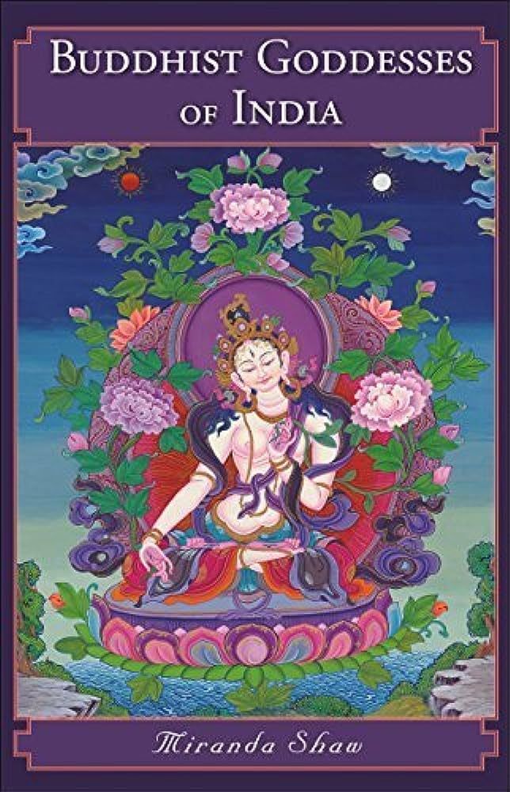
HS.52 (The Heart Sutra)
The protective power of wisdom, described here, and divine energy of Prajñāpāramitā are concentrated in the mantra and invoked by its recitation. Those who intone the mantra, the scripture promises, will be free from disease, will not die a violent death, and are assured of an auspicious rebirth. The mantra carries not only the protective force of wisdom but also its liberating power. Thus, the mantra confers all virtues, all spiritual perfections, and full awakening.
The Prajñāpāramitā mantra is clearly attributed with tremendous practical and metaphysical efficacy. The material and spiritual benefits of its recitation are inseparable, for the apotropaic power of the mantra ultimately derives from wisdom itself. Realizations associated with growth in wisdom confer a protective mantle of psychological insight, an inner sense of security and safety. Wisdom unveils the illusory nature of the world and of the self, revealing that in reality there is no “self” to be harmed. One who attains nondual insight will transcend the self-referential view point that generates dualistic dramas of victimization, conflict, and adversity, thereby removing its possessor from harm’s way.

Slide 26

HS.53 (The Heart Sutra)
Character frequency in the Heart Sutra:
21 無 (mu, "no")
9 不 (bu, "not")
7 空 (kong, "emptiness")
36 (6x6) 般 若 波 羅 蜜 多 (banya baramilta)
73 out of 270 characters (27%)
By contrast, neither 慈 nor 悲 (ja and bi,
the two main characters for compassion)
occur anywhere in the Heart Sutra!!
Why?

