Slide 1
KS.0 (The Kannon Sutra)
enmei jukku kannon gyo
kan ze on
na mu butsu
yo butsu u in
yo butsu u en
bup po so en
jo raku ga jo
cho nen kan ze on
bo nen kan ze on
nen nen ju shin ki
nen nen fu ri shin
In the first lesson we'll look at Hakuin and his relationship with the Kanzeon chant. We'll also look more closely at the first three lines.
The second lesson will go more deeply into the origins of this chant in China, especially as this is explained by the Buddhist scholar Chün-fang Yü in her book Kuan-yin: The Chinese Transformation of Avalokitesvara. And we'll look at the next three lines.
The third lesson will be about this one line!
In the fourth lesson we'll look at Zen Master Sheng Yen's explanation of why he decided to reintroduce this ancient Chinese chant back into the modern day practice of Chinese Buddhism. We'll also discuss the final four lines of the chant.

Slide 2
KS.1 (The Kannon Sutra)
延命十句觀音經
觀世音
南無佛
與佛有因
與佛有緣
佛法僧緣
常樂我淨
朝念觀世音
暮念觀世音
念念從心起
念念不離心
en mei juk ku kan on gyo
kan ze on
na mu butsu
yo butsu u in
yo butsu u en
bup po so en
jo raku ga jo
cho nen kan ze on
bo nen kan ze on
nen nen ju shin ki
nen nen fu ri shin
Long life ten phrase Kannon Sutra
Kanzeon
Homage to Buddha
With Buddha (I) have causes
With Buddha (I) have connection
Buddha Dharma Sangha connected (to me)
Eternity Bliss Self Purity
Morning mindful Kanzeon
Evening mindful Kanzeon
Mindful, mindful from Mind arises
Mindful, mindful not separate Mind

Slide 3
KS.2 (The Kannon Sutra)
Although it originated in China, the Kanzeon chant is today almost exclusively associated with Japanese Buddhism. In recent years, however, two Zen Masters from non-Japanese traditions have incorporated this chant into their teachings. More on that later.
Inoue Hyōma was an 18th century samurai. He was also a Buddhist whose practice was the recitation of the Kanzeon chant. His own personal experience was that "many marvelous things happened" as a result of reciting the Sutra. He wanted to encourage this practice, so he had copies of the chant printed and tried to circulate them. But his efforts did not receive an enthusiastic response, and he became dejected: "being a man of meager ability, no matter how much I told people about it, few of them would believe me."
Then one day this samurai had a vision in which Yama, the Lord of Hell, appeared to him and told him that people didn't respond to his attempts to encourage Kanzeon chanting because he was not a particularly virtuous person. But Yama then told him to seek out a great Zen Master named Hakuin. If he could convince Hakuin to promote this chant, people would listen to him.
So this samurai visited Zen Master Hakuin. In the biography of Hakuin written by his student Torei Enji, we are told that the meeting took place in the year 1745, when Hakuin was 60 years old. According to Hakuin's own account: "Unable to refuse him, I did as he requested. I have told people in the provinces of Harima, Bizen, Bingo, Kyoto, Osaka, Izu, Kai, Tōtōmi, and Suruga about the sutra. People of all kinds, even fishermen, servants, and the like have recited the sutra. I have heard that they acquired great benefit, according to the devotion with which they applied themselves to it."
Sources: Beating the Cloth Drum: The Letters of Zen Master Hakuin and Hakuin's Precious Mirror Cave both translated by Norman Waddell.

Slide 4
KS.3 (The Kannon Sutra)
There is a Tricycle article about Hakuin's relationship with the Kazeon chant. It begins like this "Toward the end of his life, Zen Master Hakuin took an interest in aspects of life outside the monastery walls ….."
This wording is very misleading for at least two reasons. First of all, Hakuin had many lay students throughout his entire teaching career, and when he was first starting out he actually had more lay students than monastics! And second of all, while it is true that Hakuin was 60 when he had his meeting with the samurai Inoue Hyōma and began to enthusiastically promote the Kanzeon chant, this was not "toward the end of his life", for he would live for another 23 years!
Hakuin attained his final great awakening at the age of 41. While reading the Lotus Sutra, by the way. He would live to be 83. So the period of time during which Hakuin promoted the Kanzeon chant comprises well over half of his career as an enlightened Zen Master.
One thing that Hakuin did was to immediately distribute the hundreds of left over copies of the chant that Inoue Hyōma had given to him (having been unable himself to get people to take them). Recall that Hakuin listed nine different provinces in which he had encouraged people to recite the Kanzeon Sutra. Hakuin was a very sought-after public speaker. He traveled extensively and always drew a big crowd. He not only encouraged individuals to recite the Kanzeon chant, he encouraged whole communities to chant it.
"[W]henever Master Hakuin visits other provinces to hold practice assemblies and teach the Dharma, he always urges not only his own Zen students, but all religiously minded men and women to recite it. This is something that has brought great joy to the heavenly lords that protect Buddhism and to the myriad Japanese kami as well. In villages where this sutra is recited, calamities are unknown, destructive fires and theft are unheard of, harvests are abundant, and all the villagers live at least to the age of a hundred." [The Tale of Yūkichi of Takayama, from Precious Mirror Cave]

Slide 5
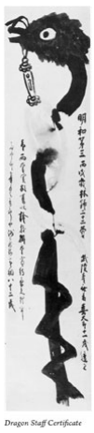
KS.4 (The Kannon Sutra)
"Iida Yasuemon, a samurai from Takayama in Hida province (the northern part of modern Gifu prefecture) whom Hakuin has narrate the bulk of Yūkichi’s tale, begins by describing the mysterious disappearance of Kojima Sōsuke. Sōsuke, an upstanding citizen of Takayama, has apparently absconded with a consignment of valuable merchandise his fellow merchants had entrusted to him. Sōsuke was a gifted Zen student who while studying with Hakuin had experienced the breakthrough known as kenshō or satori. He had gone on to become a leading figure among the close-knit community of Hakuin’s lay followers in the Takayama area. But being ignorant of the practice that continues after satori, he thought he had achieved final enlightenment and his training was over. Priests of the local Pure Land temples used Sōsuke’s suspicious disappearance as a pretext to unleash attacks on Hakuin and his Zen teaching, causing his lay followers in the city considerable embarrassment.
"While all this was taking place, a fourteen-year-old boy named Yūkichi was possessed by the deity of the large Inari Shinto Shrine in Takayama. Speaking through the young boy, the deity summons the townspeople and over a period of days delivers a series of teachings and pronouncements, in the course of which he reveals Sōsuke’s whereabouts and explains the reason for his disappearance. He then goes on to give a series of impressive formal Zen talks (teishō) in which he stoutly defends Hakuin and the methods of koan Zen and denounces the priests who have criticized him.
"Speaking through Yūkichi, the deity explains that Sōsuke’s mistake was in assuming that having received a certificate of satori from Hakuin, his Zen training was over and that he was now a fullfledged Dharma heir of the master and entitled to teach others. He goes on to point out that attainment of kenshō, as deeply significant as it is, is merely the entrance to the Buddhist life, a gateway that students must pass through before they can begin the lifelong “postsatori” practice—deepening self-attainment and eventually teaching others."
[The Tale of Yūkichi of Takayama, from Precious Mirror Cave]
"Inka Shomei"
aka
"Dragon Staff Certificate"
印可証明

Slide 6
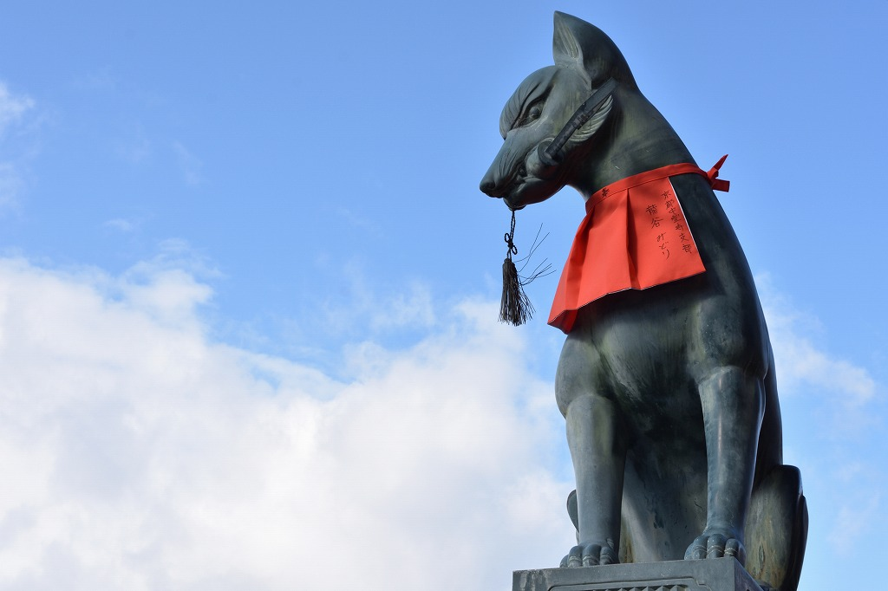
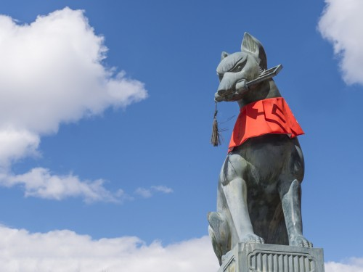
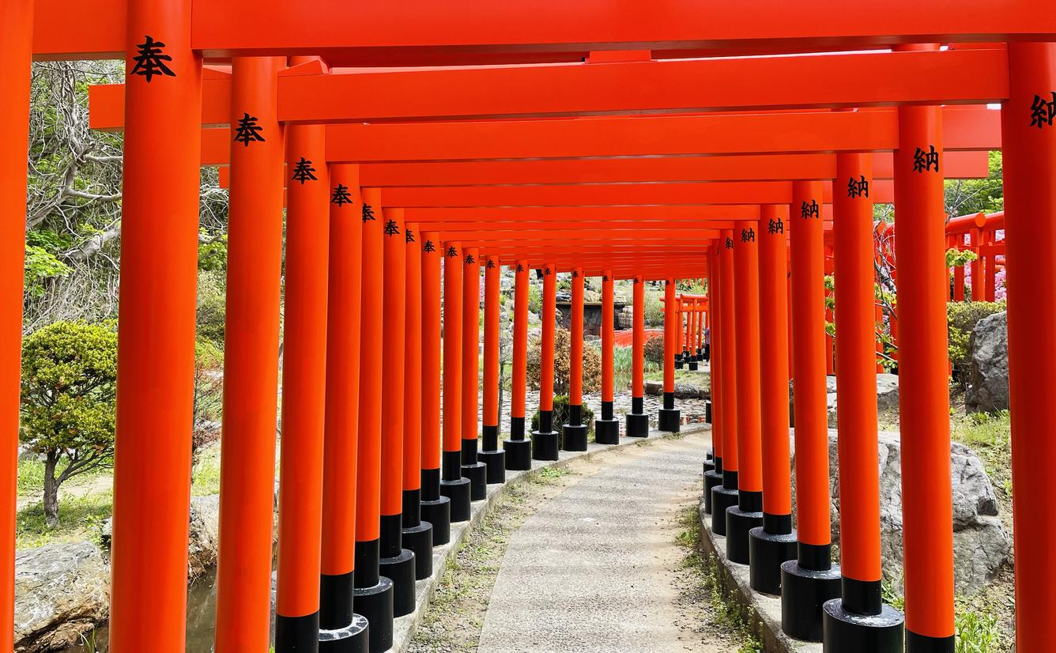
KS.5 (The Kannon Sutra)
"There is another matter that has caused special distress to the gods of heaven and earth. Since last summer, when you people had the remarkable karmic fortune to learn of the wonderful virtues of the Ten Phrase Kannon Sutra, all of you—men and women, young and old—devoted yourselves assiduously to reciting it. As a result you enjoyed especially bountiful rice harvests. Did you not rejoice in having the best harvest Takayama has seen in thirty-seven years? You might have continued to be free from natural calamities, destructive fires, theft, flood damage, accidents or other misfortunes if you had continued to recite the sutra. You would have continued to enjoy prosperity—to enjoy good health until at least the age of one hundred. What were you thinking of when you ceased reciting the sutra because of some slanders you heard from a criminal gang of renegade priests? What made you stop? Do you realize how deeply concerned the gods are about this?"
[The Tale of Yūkichi of Takayama, from Precious Mirror Cave]
The famous 1,000 Torii gates at the Takayama Inari Shrine

Slide 7
KS.6 (The Kannon Sutra)
稲 ina "rice"
荷 ri "??"
大 o "great"
神 kami
"Strange as it may seem, however, the curious tale was apparently based on actual events that took place in Takayama. Two letters Hakuin wrote to his student Katayama Shunnan, a highly respected physician from the village of Hagiwara near Takayama, have recently been published which confirm that in 1760 a youth named Yūkichi had indeed delivered a series of talks of the type described in Hakuin’s work and that he was believed by townspeople to have been possessed by the deity of the Takayama Inari Shrine. Hakuin’s astonishment at learning of the boy’s possession and the various pronouncements the deity had delivered through him is evident in the letters. The letters also seem to confirm that ordinary citizens of Takayama were aware of the events and that, in response to appeals the deity had made through young Yūkichi, they had donated and sent to Hakuin a collection of money sufficient to cover the cost of publishing a manuscript on Zen practice he had completed."
[The Tale of Yūkichi of Takayama, from Precious Mirror Cave]

Slide 8
KS.7 (The Kannon Sutra)
"It seems that long ago, there was a government official in China named Sun Ching-te who for some reason or other was thrown into prison. He was sentenced to be executed the next morning. He began that night to recite the Kannon Sutra, intending to continue throughout the night, but a little after midnight the Bodhisattva Kannon appeared to him in the form of a young monk. “It will be difficult for you to save yourself from this great peril merely by reciting the Kannon Sutra,” he said. “There is a shorter sutra called the Ten Phrase Kannon Sutra for Prolonging Life. If before morning you can recite it a thousand times, you will be spared." The Bodhisattva then proceeded to teach Sun the forty-two words that make up the sutra. He memorized them and by continuing his recitations throughout the night, he was able to complete the one thousand recitations.
"He was led to the execution ground and made to sit on a leather carpet. He stretched out his neck to receive the blade. The executioner slowly raised his great sword high over his head, and then, with a loud shout, struck downward. The blade suddenly broke into three pieces, astonishing the officials who had gathered to witness the punishment. One of them got up, drew his sword from its scabbard, and attempted to carry out the sentence himself. His blade also broke into three pieces. Further attempts by other officials ended in the same result.
"When the news reached the emperor, he was astounded. He summoned Sun Ching-te and asked him to explain what had happened. Sun told him about the appearance of the Bodhisattva and the Ten Phrase Kannon Sutra he had been given to recite. The emperor ordered five or six prisoners awaiting execution to recite the sutra a thousand times each. He then ordered their sentences to be carried out, but in every case the executioner’s blade broke into three pieces before it could strike the victim’s neck. The emperor thereupon pardoned them all, and issued a proclamation ordering each of his subjects—high and low, young and old alike—to recite the Ten Phrase Kannon Sutra a thousand times. From that moment on, the country was blessed by bountiful harvests, there were no incidents of arson, murder, or theft, and everyone lived long lives, enjoying perfect health and happiness ever after. The details of the story can be found in Extensive Records of the Buddha-patriarchs and other Sung dynasty Buddhist works." [Letter to a Donor, from Beating the Cloth Drum]

Slide 9
KS.8 (The Kannon Sutra)
The following anecdotes about Satsu are found in Stories from a Thicket of Thorn and Briar, an anecdotal collection of stories about Hakuin and his disciples compiled by Myōki, a priest three generations after Hakuin.
O-Satsu was the daughter of one of Hakuin’s cousins. When she reached the age of fifteen, she thought to herself, "I’m certainly not much to look at, but fortunately I have no physical defects. I don't think it’ll be long now before I find a suitable husband and am married." She proceeded in secret to the Akeno Kannon in nearby Yanagizawa and prayed to the Bodhisattva for help. Mornings and evenings she recited the Kannon Sutra for Prolonging Life and soon was reciting it constantly, even when she was sewing, washing, or cleaning. After a few days she suddenly experienced a realization.
[In another story ….] Satsu was doing sitting meditation while seated on a chest that contained images of the Buddha. In response to her father's reproach she said: "Show me a place where there is no Buddha, and I'll sit there!" Her father, not knowing what to make of this, went to Hakuin. Hakuin assured him that he could help her. He wrote out a waka poem: "If you can hear the voice of a crow that doesn't caw in the darkness of night, you'll welcome the father before you were born," and told the father to hang the inscription up on the wall somewhere in his house where Satsu would be sure to notice it. When Satsu saw it she said, "Priest Hakuin's handwriting I'd expect something a bit better from him." When this was reported to Hakuin, he told Satsu's father to bring her to the temple. Hakuin asked some questions. She responded easily with no hesitation. He gave her some koans. She pondered them, and a few days later penetrated their meaning ….
Later in life, Satsu's granddaughter died, and she was suffering extreme grief over the loss. An old man who lived next door came over and admonished her for weeping and wailing. "People in the neighboring village are talking about you," he said. "They say, 'She practiced under Master Hakuin. She achieved kenshō and satori.' This grief over the loss of your granddaughter is excessive. Don't you think you should reflect over your actions." Satsu glared at the man. "You confounded old codger!" she said, reviling him. "What do you know? My tears and sorrow are far better than offering her incense and flowers or lighting candles for her. You don't know anything, you old crock!" The man left without another word……
When Satsu passed away, Hakuin's disciple Suiō remarked to the assembly: "During the old master's lifetime, many people were able to attain a clear and unmistakable enlightenment. Of them all, O-Satsu stood preeminent. Even veteran monks, men who had practiced many years, could not approach her." [Biography of Hakuin, in Precious Mirror; compare this to The Story of Sul]

Slide 10
KS.9 (The Kannon Sutra)
延命十句觀音經
觀世音
南無佛
enmei jukku kannon gyo
kan ze on
na mu butsu
Long life ten phrase Kannon Sutra
Kanzeon
Homage to Buddha
延 en "prolong" (㢟 = "walk slowly")
命 mei "life, lifeforce, lifespan"
十 ju "ten"
句 ku "phrase" (this is the same as the "gu" in "shin myo jan gu dae dharani" 神妙章句大陀羅尼)
https://www.nenjudo.co.jp/page/jukku.html this page has the whole chant in hiragana – except the title itself

Slide 11
KS.10 (The Kannon Sutra)
There are many beliefs and practices in Buddhism concerning the desire to "prolong life" (enmei, 延命).
Avalokitesvara, Samantabhadra, Ksitigarbha, Amitayus, Ushnishavijaya, Medicine Buddha, and White Tara (in Tibetan Buddhism) are all especially associated with the idea that praying to a Buddha or Bodhisattva can help to prolong one's life. The simplest form of such prayers is to just repeat the name of the Buddha or Bodhisattva. Many Buddhas and Bodhisattvas also have special "long life" mantras and dharanis, and other more elaborate practices.
From Ksitigarbha Sutra: "If men, women, nagas, or spirits … wholeheartedly take refuge in this great being, their lifespans will be prolonged…." ["The Benefits of Seeing and Hearing"]
Fugen Enmei Bosatsu (普賢延命菩薩) is "Samantabhadra Life Prolonging Bodhisattva".
"Thus have I heard. Once the Buddha was on the bank of the River Ganges with a multitude of great bhiksu monks, bodhisattvas, mahasattvas, and heavenly beings. At that time Samantabhadra bodhisattva was in the assembly, abiding in the secret samadhi of the Tathagatas. He emerged out of the samadhi and showed great supernatural powers. Empowered by the Tathagatas, he preached the adamantine life-span dharani, which allows the lives of all sentient beings to be lengthened so that they do not die before their time or violent death. And it also allows (them) to obtain the firmness and indestructibility of the adamantine life-span, to achieve enlightenment, and to reach the stage of non/retrogression." [Sutra of the Most Excellent Adamantine Dharani of Samantabhadra Bodhisattva of Long Life Empowered by the Light of the Minds of All the Tathagatas, English translation by Monika Kiss]

Slide 12
KS.11 (The Kannon Sutra)
觀 kan "perceive"
音 on "sound"
經 gyo "sutra"
易經 I Ching
書經 Classic of Documents
禮經 Book of Rites
樂經 Classic of Music
道德經 Tao Te Ching
山水経 Mountains and Waters Sutra (Dogen)

Slide 13
KS.12 (The Kannon Sutra)
世 ze "world"
南 na "south"
無 mu "no"
佛 butsu "Buddha"
Digital Dictionary of Buddhism entry for 南無:
(Skt. namas; Pāli namo) To take refuge in; submit oneself to, from to bend, bow to, make obeisance, pay homage to; an expression of submission to command, complete commitment, reverence, devotion, trust for salvation, etc. It is used constantly in liturgy, incantations, etc. especially as in namaḥ Amitâbha, which is the formula of faith of the Pure Land school, representing the believing heart of all beings and Amitâbhaʼs power and will to save; repeated in the hour of death it opens the entrance to the Pure Land. Also written 南牟; 南謨; 南忙; 那謨, 那模, 那麻, 納莫, 納慕; 娜母; 曩莫, 曩謨, 捺麻, 捺謨, etc. 〔長阿含經 T 1.1.34a11〕 [Charles Muller; source(s): Soothill, Hirakawa, JEBD]

Slide 14
KS.13 (The Kannon Sutra)
www.mindisbuddha.org/writingtheox
You can explore the Kanzeon chant and other Buddhist chants using the "Writing the Ox" web application.
In this screenshot you can see all the characters of the chant. The character 常 has been selected, so it's pronunciation, meaning, and other information are being displayed.

Slide 15
KS.14 (The Kannon Sutra)
延命十句觀音經
觀世音
南無佛
與佛有因
與佛有緣
佛法僧緣
常樂我淨
朝念觀世音
暮念觀世音
念念從心起
念念不離心
en mei juk ku kan on gyo
kan ze on
na mu butsu
yo butsu u in
yo butsu u en
bu po so en
jo raku ga jo
cho nen kan ze on
bo nen kan ze on
nen nen ju shin ki
nen nen fu ri shin
Long life ten phrase Kannon Sutra
Kanzeon
Homage to Buddha
With Buddha (I) have causes
With Buddha (I) have connection
Buddha Dharma Sangha connected (to me)
Eternity Bliss Self Purity
Morning mindful Kanzeon
Evening mindful Kanzeon
Mindful, mindful from Mind arises
Mindful, mindful not separate Mind

Slide 16

KS.15 (The Kannon Sutra)
與 佛 有 因
與 = yo (yǔ) "together with"; 佛 = butsu (fó) "Buddha"; 有 = u (yǒu) "have"; 因 = in (yīn) "cause"
與 佛 有 緣
與 = yo; 佛 = butsu ; 有= u; 緣 = en (yuán) "indirect cause; condition"
佛 法 僧 緣
佛 = bu; 法 = po (fǎ) "Dharma"; 僧 = so (sēng) "Sangha"; 緣 = "en"
seed germinating
https://iowaagliteracy.wordpress.com/2018/05/04/science-101-germination/

Slide 17

KS.16 (The Kannon Sutra)
Causes and Conditions – what are they?
Well, what part of:
"That which produces a result. Cause, seed, origin, element, root. In Sarvâstivādin teachings cause is divided into six kinds; see 六因. In contrast to 'condition(s)' 緣 (pratyaya), the term refers to the primary, or most intimately related cause of an effect. In the case of the relation between 'causes' and 'conditions,' 'cause' refers to a more internal and direct cause, while 'condition' refers to external, auxiliary, and indirect causes (Skt. hetu, kāraṇa, bījatva; Tib. rgyu)." [Digital Dictionary of Buddhism entry for 因: http://www.buddhism-dict.net/cgi-bin/xpr-ddb.pl?56.xml+id(%27b56e0%27) ]
don't you understand??
https://www.thetidewaternews.com/2020/05/07/four-environmental-factors-affect-seed-germination/

Slide 18
KS.17 (The Kannon Sutra)
But wait, there's more.
According to the DDB, 因 can also very specifically refer to:
Religious practice. The practice of the bodhisattva based on the arousal of bodhicitta.
The period of bodhisattva practice (which is the 'cause' of Buddhahood).
Often in Buddhism when the subject is "causes and conditions" this is referring to the causes and conditions of suffering. But it can also refer to the causes and conditions of Buddhahood.
And just to be clear on the difference between "cause" and "condition":
For a plant, the seed is the cause.
But without soil, sunlight, and rain, the seed will never grow into a plant.
The seed will only grow under the right conditions. But even if the right conditions exist, without the seed nothing will grow (this will come up again!!).
Karma is complicated.

Slide 19

KS.18 (The Kannon Sutra)
Buddha nature is the "seed", or "cause" (因) of Buddhahood. But just as a seed will not grow into a plant unless the conditions are right (soil, sunlight, rain, etc), Buddha nature lies dormant until the arousal of Bodhicitta and the taking up of the practices of a Bodhisattva.
Yet again let's turn to the DDB entry for 緣:
"Indirect cause; secondary cause; associated conditions; causal situation, causal condition (Skt. pratyaya; Tib. Rkyen [Jp: "en"]). All things are subject to the principle of cause and effect, but there are conditions/circumstances that aid the causes that produce an effect, which are called indirect causes. Given the strong attention that Buddhism pays in general to matters of causation, especially as seen in the theory of dependent arising, the matter of associated causes and factors is seen in almost any discussion. Seen in contrast with 因 hetu [Jp: "in"], the direct or fundamental cause. Hetu is like a seed, pratyaya the soil, rain, sunshine, etc."

Slide 20
KS.19 (The Kannon Sutra)
There are of course a great many English translations of the Kannon Sutra. It is interesting and useful to look at them, but most of them are terrible. Also one can find many different explanations of the meaning of the chant. Again, it is interesting and useful to look at those explanations as well. It's good to see how others have sincerely struggled to translate and explain this chant. We can appreciate and sympathize with their struggles without buying into their interpretations. The most important thing, though, is to realize just how terrible our own interpretations are.
The Dharma Rain Zen Center in Portland, Oregon, has a nice document on their website that you can download as a pdf:
https://dharma-rain.org/wp-content/uploads/2022/04/Enmei-Jukku.pdf. That document brings together three different explanations of the Sutra, and a dozen different translations.
The three lines we are looking at right now all have to do with the causes and conditions of the Bodhisattva path, which is the path to Buddhahood. The one direct indispensable immediate cause of Buddhahood is universal Buddha nature. Since this Buddha nature pervades the whole universe, it is present everywhere at all times.
But what are the conditions necessary for that seed to grow, that is, for us to actually begin to walk on the Bodhisattva path? Whenever we chant this Sutra, by that very fact we are demonstrating that we already have not only the primary cause, Buddha nature, but also all of the necessary secondary conditions. The more we chant, the stronger those conditions become.
緣, "en", is often translated as "affinity". This is useful because it suggests that we can strengthen our "affinity" with Buddha, Dharma, and Sangha. And one way to do that is to chant the Extend Life Ten Phrase Kannon Sutra.

Slide 21
KS.20 (The Kannon Sutra)
The boy Yūkichi remained possessed by the Inari Okami for three days and three nights. Each night a crowd gathered and the deity would deliver a talk. This is from the third and final talk:
“At sundown the following day, people packed into the extremely cramped quarters of the room adjacent to Yūkichi’s chambers and began performing the usual one hundred repetitions of the Ten Phrase Kannon Sutra. When they finished, the sliding doors opened and the deity began to speak: ‘Well, well, I am glad to see such a large gathering. This will be the last time I address you.
“‘What is to be feared above all else are the eight terrifying hells that await beings in the next existence: the unspeakable suffering of the Great Shrieking Hell, the Hells of the Red Lotus, the Great Red Lotus, the Scorching Heat, and so on. If anyone here were to glimpse even from a great distance the agony victims undergo in one of these hells, it would cause such great distress, such turmoil of mind, that you would immediately start spewing up blood and faint dead away. For this reason, you must devote yourselves assiduously to the Ten Phrase Kannon Sutra. Repeat it over and over.
“‘The most important thing you can accomplish during your sojourn on earth is to attain satori—the breakthrough known as kenshō. Unless you do that, it won’t matter how many good deeds you perform because none of them will bring any merit or benefit at all. As useless as painting pictures in the water or cultivating flowers in the air! Even if you practice the most rigorous austerities for twenty or thirty years and experience the incalculable joy of eighteen great satoris and innumerable smaller ones, so long as you lack the Bodhi-mind because you do not encounter a true teacher and learn about the practice that goes on after satori, you will be unable to avoid falling into the horrendous torments of the hellish regions….
“‘By Bodhi-mind I mean the mind that undertakes the practice that comes after satori, which consists of proceeding forward and deepening your own enlightenment while at the same time helping those who have been left behind to achieve awakening as well. It is the great and wonderful activity of constantly teaching the Dharma, bringing joy by relieving suffering and rejoicing at the freedom and happiness thus attained, and yet through it all remaining completely unattached. This, it is said, creates the causes and conditions for a Buddha-land on earth; it is the awe-inspiring activity of the Bodhisattva….

Slide 22
KS.21 (The Kannon Sutra)
“‘In the fourth chapter of the Vimalakirti Sutra, Layman Vimalakirti says: "It is like one lamp lighting up a hundred thousand lamps. All the darkness becomes brightness, and the brightness is never exhausted. Because a single Bodhisattva arouses in a hundred thousand living beings the Bodhi-mind that seeks supreme, perfect enlightenment, the Bodhisattva-activity of spreading the Dharma is unceasing. That is the meaning of ‘inexhaustible lamp.’ It is also the cause and condition for creating a Buddha-land on earth, and the awe-inspiring activity of the Bodhisattva."
“‘The primary objective for superior students engaged in authentic Zen practice must be to become such a lamp. To do that you must arouse a great burning desire, vowing to follow the way with dauntless courage, enduring infinite pain and suffering, grudging neither life nor limb, until you achieve a kenshō of such clarity that you can see it as though you are looking at it in the palm of your hand…..
“‘We can say, in describing the inexhaustible lamp, that its wick is the koans, the claws and fangs of the Dharma cave that bring about true and authentic kenshō; that the base on which it stands is a benevolent heart and body that is always unwaveringly firm; that its oil is the heart of great compassion that strives to lead sentient beings to liberation, to eliminate their suffering and bring them happiness; that the flame is the body of great wisdom, whose true aspect is essentially formless and nondual; that its light is the Dharma preaching, boundlessly great, imparted unceasingly with perfect freedom and eloquence to all beings in accordance with their different capacities, even till the end of time.
“‘Among these, what must be specially valued, and what must be scrupulously replenished, is the oil of great compassion that strives to lead beings to liberation by preaching the Dharma. There is no Bodhi-mind apart from this. If you were to place a thousand wicks, even ten thousand wicks, on a lamp stand, you would produce light to brilliantly illuminate the four directions. But once the oil was exhausted, you wouldn’t need a wind to extinguish them, they would die out of themselves. Not a flicker of light would be left behind. The oil is the Bodhi-mind of great compassion that liberates sentient beings. Without it they would all fall into the paths of the evil ones when they died."

Slide 23
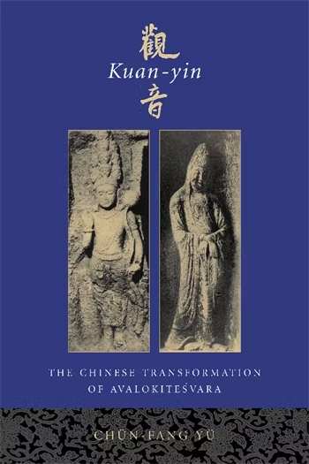
KS.22 (The Kannon Sutra)
"The origin of this scripture lies with the story about a person being saved from imprisonment and impending execution by chanting this very sutra revealed by Kuan-yin. The miracle moved 'King Kao,' who pardoned the prisoner and spread the sutra. But who was this unfortunate prisoner and who was this King Kao? Buddhist chronicles and secular histories suggest three different candidates for the hero of the story: Wang Hsüan-mo (388–468), Lu Ching-yü (d. 542), and Sun Ching-te, who also lived in the sixth century. King Kao, on the other hand, could be no other than Kao Huan (496–547), the powerful prime minister of the Eastern Wei and the titular founder of the Northern Ch'i." [Chün-fang Yü, p. 111]
But what scripture is Chün-fang Yü talking about? It may or may not be the Extend Life Ten Phrase Kannon Sutra. Why is that? Well, she is specifically talking about the King Kao's Kuan-shih-yin Sutra. Is that the same scripture? In the form that it is currently known in China it is certainly different. But has this always been the case? What, if anything, is the historical relationship between the "Ten Phrase" Sutra and the much longer "King Kao's" Sutra? This is made more complicated by the fact that both Sutras have multiple names, and both of them are sometimes simply referred to as the "Kuan Yin Sutra", which is also the name commonly given to the 25th chapter of the Lotus Sutra.
Kuan-yin: The Chinese Transformation of Avalokitesvara
By Chün-fang Yü
https://cup.columbia.edu/book/kuan-yin/9780231120296

Slide 24
KS.23 (The Kannon Sutra)
One fairly early source directly links the "Ten Phrase" Sutra with the story of a condemned prisoner who is miraculously saved from execution. That source is the "Extended Record of the T'ai-p'ing Era" which was completed in 983 AD:
"[Wang] dreamt of a person telling him that if he recites the Kuan-yin Sutra a thousand times, he can escape from this disaster. Wang answered that he might lose his life at any moment, how could he find enough time to do that? The person then taught him to chant ten sentences which are: 'Kuan-shih-yin, Adoration of the Buddha, there is a cause linking me with the Buddha, there is a condition linking me with the Buddha, Buddha and Dharma are mutually linked;
eternity, bliss, true-self, and purity; I call Kuan-shih-yin in the morning, I call Kuan-shih-yin in the evening, each call comes from the mind, Buddha-invocation is not separate from the mind.' When Wang woke up, he chanted it a thousand times. When he was about to be executed, General Shen Ch’ing-chih remonstrated with the throne and Wang was pardoned." [Chün-fang Yü, p. 114]
In the above version of the story, the prisoner in question is identified as Wang Hsüan-mo (388–468). But as previously noted, there are at least two other versions of this story with different protagonists: Lu Ching-yü (d. 542), and Sun Ching-te (6th century). You might recall that when Hakuin (1686-1769) referred to what he considered to be the historical origins of the Ten Phrase chant, he named the prisoner as Sun Ching-te (see slide KS.7).
While the "Extended Record of the T'ai-p'ing Era" very helpfully provides us with the entire text of the chant in question, it does not identify this as the "King Kao's Kuan-shih-yin" chant. However, the "King Kao" chant does contain the first six of the "Ten Phrases" (more or less). Also, a later source (see next slide) does explicitly state that the "Ten Phrase" Sutra is the original form of what later became known as "King Kao's" Sutra.

Slide 25
KS.24 (The Kannon Sutra)
The Record of the Lineage of the Buddha and the Patriarchs [佛祖統紀] (fózǔ tǒngjì) compiled in 1269 by the T’ien-t’ai priest Chih-p’an, explicitly states that the "Ten Phrase" Sutra was the original form of the "King Kao" Sutra:
"The sutra has only ten sentences. It was no other than the one transmitted to Wang Hsüan-mo of the Sung dynasty (424–479) and the one recited by Sung Ching-te which is being printed today in the marketplace. But people
in later generations have expanded it capriciously so that its phraseology has become vulgar and uneven, causing knowledgeable people to doubt its authenticity. In our dynasty, during the Chia-yu era (1056–63) Lung Hsüehmei's wife lost her eyesight. She was advised to pray at the Upper T'ien-chu Monastery. One night she dreamt that a person in white taught her to chant the "Kuan-yin Sutra in Ten Sentences." She chanted it without ceasing and recovered her sight in both eyes. Mr. Chao of Ch'ing-hsien wrote about it and published it. Kuan-yin taught this extremely succinct text to save people from great danger, and from those ancient times until now there have been three miraculous responses. Do we dare not to believe it?" [quoted by Chün-fang Yü on p. 115]
This sounds very nice and neat, but the similarities between the two texts is really not that great (see next slide). In an endnote Chün-fang Yü directly addresses the issue of the last four phrases, and states "The last four phrases are similar to some found in a Tun-huang sutra known as Chiu-k'u Kuan-shih-yin ching (S 4456), which is also known as a variant name for Kao Wang Kuan-shih-yin ching. It contains the following phrases: 'I chant (or think) Kuanshih-yin in the morning, I chant Kuan-shih-yin in the evening, I chant Kuan-shih-yin while sitting, I chant Kuan-shih-yin while walking, each chanting (or thought) gives rise to another chanting, Buddha-invocation does not depart from the mind.' Makita suggested late T'ang or the eighth century as the date this sutra was composed in Gikyo kenkyu (1976:69). The so-called 'Kuan-yin Sutra in Ten Phrases' seems to consist of parts from both Kao Wang Kuan-shih-yin ching and Chiu-k'u Kuan-shih-yin ching. Kiriya made a careful comparison between the 'Kuan-yin Sutra in Ten Phrases' and existing five recensions of the Kao Wang Kuan-shih-yin ching (1990:15–16)." [endnote 9 on p. 524]

Slide 26
KS.25 (The Kannon Sutra)
"High King Avalokitesvara Sutra" (https://tbsec.org/諸尊手印與心咒/高王觀世音 )
Also see: https://tripitaka.cbeta.org/T85n2898_001
奉請八大菩薩名號：南無觀世音菩薩摩訶薩、南無彌勒菩薩摩訶薩、南無虛空藏菩薩摩訶薩、南無普賢菩薩摩訶薩、南無金剛手菩薩摩訶薩、南無妙吉祥菩薩摩訶薩、南無除蓋障菩薩摩訶薩、南無地藏王菩薩摩訶薩、南無諸尊菩薩摩訶薩
觀世音菩薩。南摩佛。南摩法。南摩僧。佛國有緣。佛法相因。常樂我淨。有緣佛法。南摩摩訶般若波羅蜜是大神咒。南摩摩訶般若波羅蜜是大明咒。南摩摩訶般若波羅蜜是無上咒。南摩摩訶般若波羅蜜是無等等咒。南摩淨光秘密佛。法藏佛。獅子吼神足幽王佛。佛告須彌燈王佛。法護佛。金剛藏獅子遊戲佛。寶勝佛。神通佛。藥師琉璃光王佛。普光功德山王佛。善住功德寶王佛。過去七佛。未來賢劫千佛。千五百佛。萬五千佛。五百花勝佛。百億金剛藏佛。定光佛。六方六佛名號。東方寶光月殿月妙尊音王佛。南方樹根花王佛。西方皂王神通燄花王佛。北方月殿清淨佛。上方無數精進寶首佛。下方善寂月音王佛。無量諸佛。多寶佛。釋迦牟尼佛。彌勒佛。阿閦佛。彌陀佛。中央一切眾生。在佛世界中者。行住於地上。及在虛空中。慈憂於一切眾生。各令安穩休息。晝夜修持。心常求誦此經。能滅生死苦。消除諸毒害。南摩大明觀世音。觀明觀世音。高明觀世音。開明觀世音。藥王菩薩。藥上菩薩。文殊師利菩薩。普賢菩薩。虛空藏菩薩。地藏王菩薩。清涼寶山億萬菩薩。普光王如來化勝菩薩。念念誦此經。七佛世尊。即說咒曰：「離婆離婆帝。求訶求訶帝。陀羅尼帝。尼訶囉帝。毗黎尼帝。摩訶伽帝。真陵乾帝。梭哈。」(七遍)
十方觀世音。一切諸菩薩。誓願救眾生。稱名悉解脫。若有智慧者。殷勤為解說。但是有因緣。讀誦口不輟。誦經滿千遍。念念心不絕。火焰不能傷。刀兵立摧折。恚怒生歡喜。死者變成活。莫言此是虛。諸佛不妄說。高王觀世音。能救諸苦厄。臨危急難中。死者變成活。諸佛語不虛。是故應頂禮。持誦滿千遍。重罪皆消滅。厚福堅信者。專攻受持經。願以此功德。普及於一切。誦滿一千遍。重罪皆消滅。高王觀世音真經終。

Slide 27
KS.26 (The Kannon Sutra)
延命十句觀音經
觀世音
南無佛
與佛有因
與佛有緣
佛法僧緣
常樂我淨
朝念觀世音
暮念觀世音
念念從心起
念念不離心
en mei juk ku kan on gyo
kan ze on
na mu butsu
yo butsu u in
yo butsu u en
bu po so en
jo raku ga jo
cho nen kan ze on
bo nen kan ze on
nen nen ju shin ki
nen nen fu ri shin
Long life ten phrase Kannon Sutra
Kanzeon
Homage to Buddha
With Buddha (I) have causes
With Buddha (I) have connection
Buddha Dharma Sangha connected (to me)
Eternity Bliss Self Purity
Morning mindful Kanzeon
Evening mindful Kanzeon
Mindful, mindful from Mind arises
Mindful, mindful not separate Mind

Slide 28
KS.27 (The Kannon Sutra)
觀世音
南無佛
與佛有因
與佛有緣
佛法僧緣
Refuge
Bodhisattva Path
Bodhicitta (causes and conditions; aspiration, application, absolute)
causes and conditions
Nirvana / Buddhahood
result
常 樂 我 淨
佛

Slide 29
KS.28 (The Kannon Sutra)
常 jo eternal, unchanging, permanent
樂 raku joy, happiness, bliss
我 ga self, I, me
淨 jo pure, clean, unspoilt
From the Digital Dictionary of Buddhism
http://www.buddhism-dict.net/cgi-bin/xpr-ddb.pl?56.xml+id(%27b56db-5fb7%27)
四德 [lit: four virtues]
Four positive attributes of Buddhist religious experience that are taught as an antidote to the negativity of teachings such as that of emptiness (Skt. catvāraḥ guṇa; Tib. yon tan bzhi). One of the best known sources for this notion is the Nirvāṇa-sūtra, which teaches the four attributes of nirvana to be:
常德 permanence or eternity;
樂德 joy;
我德 personality or the soul;
淨德 purity.

Slide 30
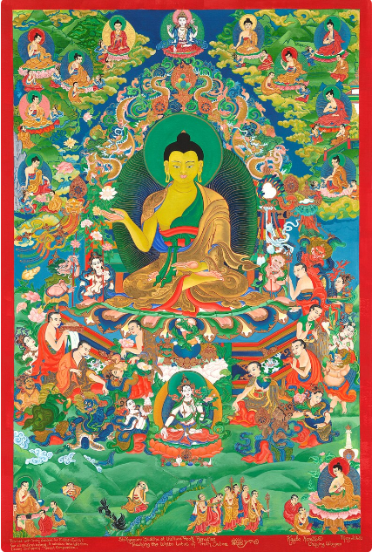
KS.29 (The Kannon Sutra)
"Thereupon the Buddha emitted from the white tuft between his eyebrows a light, which illuminated eighteen thousand worlds to the east, omitting none of them." [Lotus Sutra, Chapter One]
"The white hair tuft centered between the; Buddha's eyebrows is called the precious seal of the reality mark of the middle Way, and represents The Four Virtues of Nirvana, permanence [常 jo] , bliss [樂 raku], true self [我 ga], and purity [淨 jo]. The tuft has a hollow center, which represents permanence; the exquisiteness of the hair tuft represents bliss; its softness represents true self, and its white color represents purity. The light of the white tuft universally illumines the ultimate potential of all living beings, that is, Buddhahood, and among all the sutras, it is only in The Dharma Blossom that the Buddha emits this light. This indicates that The Dharma Blossom Sutra is the complete, sudden Dharma-door to the Buddha's wisdom, based on the reality mark."
[Commentary by Venerable Master Hsuan Hua, from the September, 1973, issue of Vajra Bodhi Sea:
http://www.drbachinese.org/vbs/1_100/vbs42/vbsT_42.html ]
Buddha teaching the Lotus Sutra
Thangka by Kalyano Komito Sacred Art:
https://www.etsy.com/shop/KaylaKomitoSacredArt

Slide 31

KS.30 (The Kannon Sutra)
Notice in the previous slide how Venerable Master Hsuan Hua feels obligated to translate 我 (ga) as "true self". In a 1996 article on the "Kannon Sutra", Tricycle magazine (link) goes even further and translates 我 (ga) as "selfless"!
Anyone who has taken a basic course in Mandarin knows that the character 我 (Jp: ga; Mn: wǒ), is just the first person pronoun used in everyday speech: "I, me, my". It is much less commonly used in Japanese (which has many different first person pronouns), but when it is used in Japanese it still just means "I". The situation is similar in Korean, where 我 (pronounced "ah" in Korean) is considered archaic or literary, but still just means "I".
In fact, each of the Four Virtues of Nirvana is quite problematic, taken in isolation. Although "Self" (我; ga) seems to create the greatest amount of consternation.
Impermanence, Suffering, and No-Self are considered "dharma seals". Any teaching not consistent with impermanence, suffering, and no-self is by definition not consistent with the Buddha Dharma. And of course in the Heart Sutra Avalokitesvara teaches that nothing is "pure or tainted" (不 垢 不 淨, "bul gu bu jeong").
Here is a longish quote from Master Sheng Yen on "the four virtues of nirvana":
Suffering stems from impermanence and impurity. Even joy becomes suffering because it doesn't last. Eventually, we lose things we love, we get sick, we die. The four virtues of permanence, joy, self and purity refer to nirvana, wisdom and Buddha-nature. These things have no beginning or end, so of course they are permanent. Nirvana does not start when a person attains Buddhahood. Nirvana has always been, without beginning. The same is true for Buddha-nature. It is not because you practice that Buddha-nature begins. Buddha-nature has always existed. The same is true for natural wisdom. These three things are truly permanent. They haven't changed from impermanence to permanence. Permanence cannot grow out of impermanence. Truly permanent things have always been permanent.
A typical google image search result for 快樂
(lit: "happy happy"). Image from here: https://womany.net/read/article/3263

Slide 32
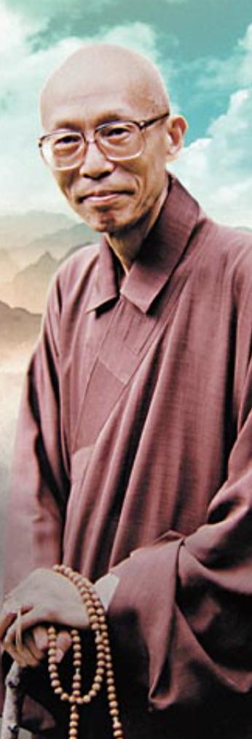
KS.31 (The Kannon Sutra)
Again, true joy does not come and go. True joy is uninterrupted and permanent. Every evening I ask, "Has today been a good day?" Some say yes, some say no, some remain silent. For the people who raise their hands, was it truly a good day? To truly have a good day, you must have an understanding of what a good day is. You would have to experience good days all the time. All days must be equally good. If you say that today is a good day, but yesterday wasn't, then today wasn't truly good either. It's good only in comparison to the previous day. Tomorrow may be better. Does that mean that today wasn't quite as good as you thought it was? If you were to say that all your days have been good, and then leave this retreat and get hit by a truck, would you stick to your word and say, "Ah, today's a good day"? …..
The self that we experience in ordinary life is not the true self. It is an illusion - our imagination and vexations. Reflect on this. What is it that you consider your self? There really is no such thing. It is the piecing together of various illusions and thoughts. We speak of the self as something which belongs to "me," something that's "mine," or something "I am." It is only consecutive thoughts, the previous thought generating a subsequent thought, which create the illusion of a self. There is only an illusory mind which derives from vexations. Vexations, in turn, come from fundamental ignorance, and fundamental ignorance has no beginning….
Something that is truly pure never changes, never moves. Fundamentally, there is no such thing as purity or impurity. We make distinctions between purity and impurity because of our confusion and discrimination. But there can never be true purity while there is discrimination, and discrimination comes from the mind of illusion and vexation.
The true states of permanence, joy, self and purity refer to nirvana; but if, when you enter nirvana there are still four virtues, then it is really attachment and you have not entered it. These so-called four virtues are only goals that lead us toward nirvana. Upon entering nirvana, there is no discrimination left, and therefore no need to speak of true virtues of permanence, joy, self and purity.
From Master Sheng Yen's commentary on Niutou Farong's Song of Mind
http://www.chancenter.org/chanctr/ddp/chanmag/sum1996.html

Slide 33
KS.32 (The Kannon Sutra)
Refuge and Bodhicitta are the Cause
Bodhicitta of Aspiration: "But what is the great purpose that makes this long training possible? It is the aspiration or vow to assist all beings, and our most cherished ambition must be to transmit the Dharma and to liberate beings. From this aim comes the first dedication of the heart, and with the strength from this aim we can break our bones in the training." [The Discourse on The Inexhaustible Lamp of the Zen School by Zen Master Torei Enji, p. 24]
Bodhicitta of Application: "The Buddha found that what he taught [in the Avatamsaka Sutra] from the viewpoint of Satori was too difficult, and so he resorted to skillful means to lead people toward it. He came down from the peak of full enlightenment and entered the Deer Park. There he first taught the Four Noble Truths, bringing five disciples to awakening. These five were the ones who had lived with him before his enlightenment, looking after him and practising austerities with him…. Next, the Buddha taught the Six Paramitas. Paramita is a Sanskrit word which means crossing to the other shore. The Six Paramitas are: Giving, Keeping the Precepts (Sila); Patience; Devoted Effort or Application; Meditation; and Wisdom. When these six virtues of the Way are actually realized in practice, then from this shore of error the ideal far shore of Satori is reached. A Bodhisattva is one who, with this insight, delivers himself as well as others." [Torei, p. 41-46]
Absolute Bodhicitta: "Turning the Wheel of the Dharma is the beginning and end of the whole training. With this aspiration one starts giving one's whole heart to the training; with one's heart in it, one does it. Depending on it, one looks for the wonder arousing, mysterious state behind the differentiations. That attained, the transformation of one's life has been completed. One grasps the fangs and claws of the Dharma-cave, and without let or hindrance freely walks the way of the gods, entering the coarse and the fine, the real and the seeming, raising one or two genuine seedlings and transmitting the Dharma to one's heirs, so that it can continue for ever as a brilliant light shining upon the world." [p. 23]

Slide 34
KS.33 (The Kannon Sutra)
The Sutra of the Pure Name [Vimalakirti Sutra] states, 'If you are bound yourself, you cannot untie another's bonds.'
So we seek the completion of wisdom for the sake of all sentient beings, and in order to attain it, we first need to see into (our) True Nature (Kensho). However, this is not to be understood as striving to become Buddha (as the main purpose), and only then (secondarily), to assist sentient beings, but rather we seek to become Buddha in order to assist all sentient beings. Yet again, this should not be understood in the sense that by assisting all sentient beings we become Buddha, but rather every step on the Buddha's Way is taken for the sake of all sentient beings. Thus followers of the Buddha's Way first need to cast off the sense of "I", and not to cling to any advantage of their own.
In the Nirvana Sutra the Buddha is quoted as saying, 'The aspiring heart is not split into two. Were there two hearts, the other (heart) would make for difficulties. Though not yet being delivered itself, it first (strives) to deliver others, so above all I do reverence to the aspiring heart.
The first requirement for trainees, therefore, is to let go of "I" and not to cling to their own advantage.
[Discourse on the Inexhaustible Lamp, pp. 179-181]
見性
ken shō
Basic Meaning: to see the
(buddha-)nature
To see oneʼs own originally enlightened mind. To behold the Buddha-nature within oneself, a common saying of the Chan school, as seen for example, in the phrase 'seeing oneʼs nature, becoming Buddha' 見性成佛 (Skt. dṛṣṭi-svabhāva, dṛś, dṛṣṭi).
[Digital Dictionary of Buddhism:
http://www.buddhism-dict.net/cgi-bin/xpr-ddb.pl?89.xml+id(%27b898b-6027%27) ]

Slide 35

KS.34 (The Kannon Sutra)
The Bodhicitta of Aspiration, merely "wishing" for all beings to be free of suffering and of the causes of suffering, might seem almost insignificant.
But according to Shantideva it is nothing short of a miracle. It is literally something that "just happens" to you. You yourself do not choose the first arising of Bodhicitta.
Like final complete enlightenment (anuttara samyak sambodhi) bodhictitta "cannot be brought about". But unlike anuttara samyak sambodhi, it does arise. And once arisen, it can increase … and it can also decrease. It can also be lost altogether. But once lost it can still be recovered.
(All quotes are from Shantideva's Way of the Bodhisattva.)
Image from npr.org: How Lightning Shapes The Climate
"Just as on a dark night black with clouds,
The sudden lightning glares and all is clearly shown
Likewise rarely, through the Buddha's power,
Virtuous thoughts rise, brief and transient, in the world".
"Just as a blind man might find a jewel amongst heaps of rubbish, so this Bodhicitta has somehow arisen in me."
"When the Bodhicitta has arisen, in an instant a wretch who is bound in the prison of the cycle of existence is called a Child of the Sugatas and becomes worthy of reverence in the worlds of gods and humans."

Slide 36
KS.35 (The Kannon Sutra)
Yoshifumi Ueda, 1968:
All forms of Buddhism take as their foundation going out from this world of suffering (samsara) and attaining the transcendent (nirvana). This is often assumed to entail a renunciation of ordinary life, an idea reinforced by the figure of Sakyamuni, whose abandonment of family and throne presents a thoroughgoing repudiation of the values of secular life. During Sakyamuni’s lifetime, however, there were strong bonds between the disciples who had renounced homelife and the laity that remained in the secular world, and in the person of the Buddha, who embodied the transcendent, both his mendicant disciples and his lay followers were able to find salvation. Still, the negative aspect of Buddhism—that of transcending the mundane world—is strong in Sakyamuni’s teaching, and after Sakyamuni’s death the distinction between lay and monk solidified.
Mahayana Buddhism arose as a movement to reunite the laity and the monks and nuns by overcoming the distinction between lay and monk, the world of ordinary life and the world of nirvana. Mahayana saw the earlier Buddhism as one that sought nirvana by abandoning the world of samsara and thus knew nothing of benefiting others, that is, leading the laity to enlightenment. It therefore labeled such Buddhism “Hinayana," the small vehicle, while proclaiming itself the great vehicle.
Mahayana does not teach abandonment of samsara. It considers it an error to seek the transcendent apart from the secular world, and is established at the point where the dualistic thinking of Hinayana is broken through. The true transcendent realm also transcends the distinction between samsara and nirvana, and is attained not through renouncing everyday life but through transforming it at its roots. To borrow Dogen’s words, "Realize that samsara is none other than the life of Buddha" (Shobogenzo shoji). Living ordinary life is itself the life of Buddha. In attaining this mode of existence lies the fundamental character of Mahayana.

Slide 37
KS.36 (The Kannon Sutra)
That samsara is not abandoned must not be understood superficially, for one does indeed go out from samsara. But while the person who simply dwells in samsara is attached to it and does not seek nirvana, the one who has abandoned samsara to dwell in nirvana (Hinayana sage) is attached to nirvana. The true transcendent realm is free of all forms of attachment. Moreover, the person who has realized nirvana experiences the sameness (samata) of sentient beings in samsara and himself, that is, the fact that the minds of sentient beings and his own mind are one. When the mind thus awakened turns towards sentient beings in samsara, it is called great compassion. One goes out from samsara and reaches nirvana, but without abiding in nirvana compassionately re-enters the world of samsara. Since the awakened one abides neither in samsara nor nirvana, there is nowhere that he abides. Hence, the Mahayana concept of nirvana is "nirvana of no abiding place".
In order to reach the transcendent, Mahayana Buddhists practiced the "three learnings" (precepts, meditation, wisdom). In other words, they walked the path of renunciation of secular life. This did not mean that one could not reach the transcendent unless one entered a life of monastic discipline and practice; renouncing homelife was significant only as a tested method for transforming the world of ordinary life and grounding it in the transcendent. Monastic life is unnecessary if one is able to attain the transcendent while living in the mundane world. This is the Mahayana spirit, typically expressed in the Vimalakirti Sutra, in which layman Vimalakirti is depicted as superior to bodhisattvas who have renounced the world. But even though the distinction between monk and lay was erased in spirit, it was not until the Pure Land Buddhism of twelfth century Japan that a reliable method to replace the three learnings was established.
[The Mahayana Structure of Shinran’s Thought PART I Yoshifumi Ueda, 1968] https://otani.repo.nii.ac.jp/record/8927/files/EB17-1-06.pdf ]

Slide 38
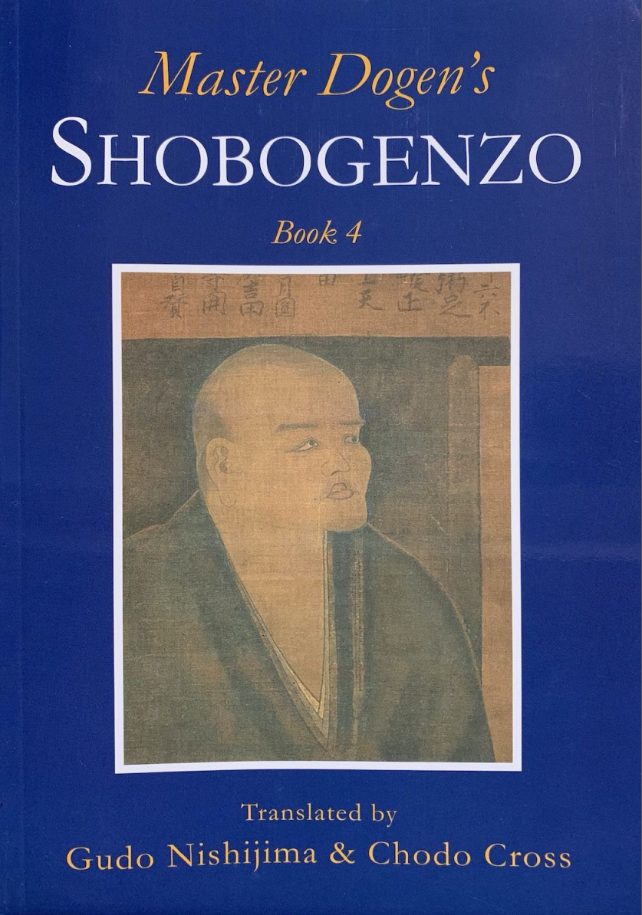
KS.37 (The Kannon Sutra)
生死 SHOJI Life-and-Death [Shobogenzo, Chapter 92]
Because in life-and-death there is Buddha, there is no life and death. Again, we can say: Because in life-and-death there is no "Buddha," we are not deluded in life-and-death. [This] meaning was expressed by Kassan and Jozan. [These] are the words of the two Zen Masters; they are the words of people who had got the truth, and so they were decidedly not laid down in vain. A person who wishes to get free from life and death should just illuminate this truth. If a person looks for Buddha outside of life-and-death, that is like pointing a cart north and making for [the south country of] Etsu, or like facing south and hoping to see the North Star. It is to be amassing more and more causes of life and death, and to have utterly lost the way of liberation. When we understand that only life-and-death itself is nirvana, there is nothing to hate as life and death and nothing to aspire to as nirvana. Then, for the first time, the means exist to get free from life and death. To understand that we move from birth to death is a mistake. Birth is a state at one moment; it already has a past and will have a future. For this reason, it is said in the Buddha-Dharma that appearance is just non-appearance. Extinction also is a state at one moment; it too has a past and a future. This is why it is said that disappearance is just non-disappearance. In the time called life, there is nothing besides life. In the time called death, there is nothing besides death. Thus, when life comes it is just life, and when death comes it is just death; do not say, confronting them, that you will serve them, and do not wish for them.
Volume 4 of Dogen's Shobogenzo (containing the chapter "Shoji") is available for purchase and also for free pdf download at the BDK American website here:
https://www.bdkamerica.org/product/shobogenzo-the-true-dharma-eye-treasury-volume-iv/

Slide 39
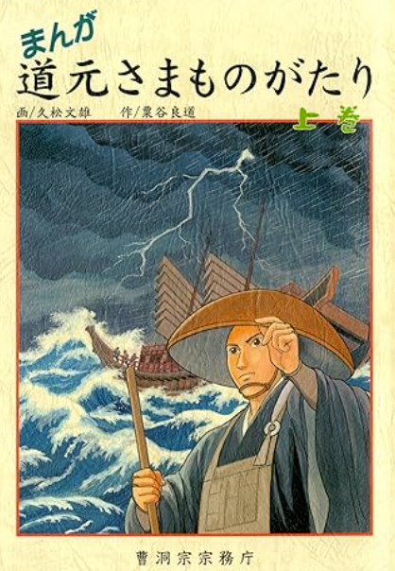
KS.38 (The Kannon Sutra)
This life-and-death is just the sacred life of buddha. If we hate it and want to get rid of it, that is just wanting to lose the sacred life of buddha. If we stick in it, if we attach to life-and-death, this also is to lose the sacred life of buddha. We confine ourselves to the condition of buddha. When we are without dislike and without longing, then for the first time we enter the mind of buddha. But do not consider it with mind and do not say it with words! When we just let go of our own body and our own mind and throw them into the house of buddha, they are set into action from the side of buddha; then when we continue to obey this, without exerting any force and without expending any mind, we get free from life and death and become buddha. Who would wish to linger in mind?
There is a very easy way to become buddha. Not committing wrongs; being without attachment to life-and-death; showing deep compassion for all living beings, venerating those above and pitying those below; being free of the mind that dislikes the ten thousand things and free of the mind that desires them; the mind being without thought and without grief: this is called buddha. Look for nothing else. [pp. 197-198]
Manga Dogen-sama Monogatari 3-volume set
"A manga story that can be enjoyed by both children and adults"
https://shop.sotozen-net.or.jp/products/detail.php?product_id=212

Slide 40
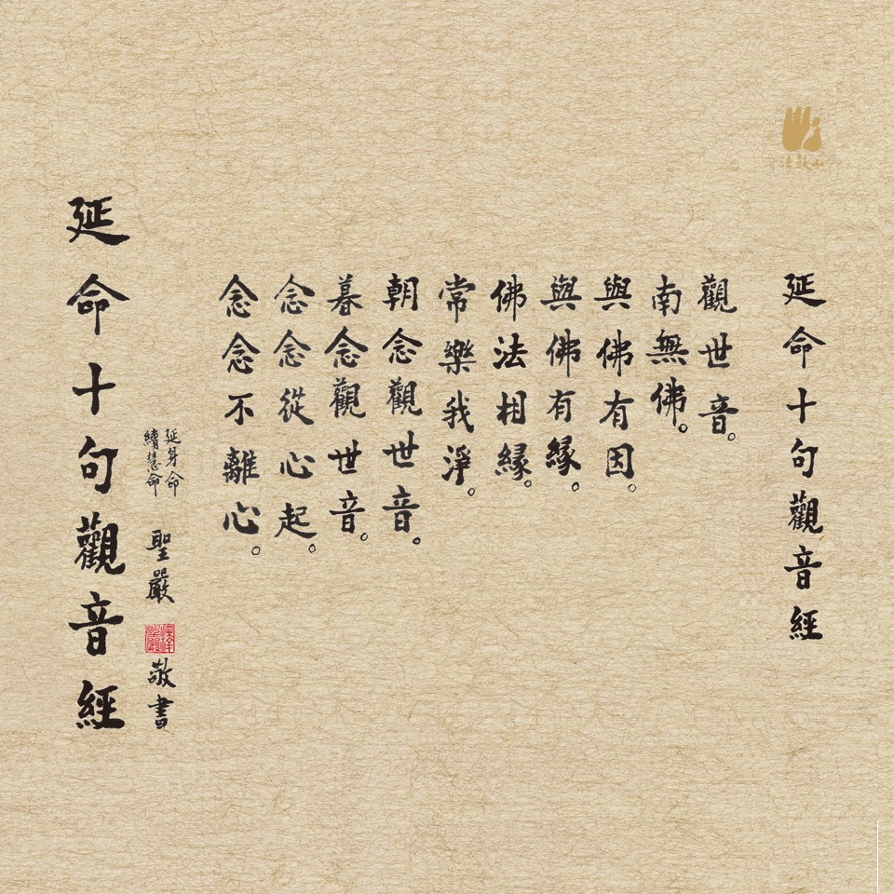

KS.39 (The Kannon Sutra)
延命十句觀音經
Ten Verse Kannon Sutra
えんめいじっくかんのんぎょう
From the Facebook group:
全球佛教 Global Buddhism:
https://www.facebook.com/global.buddhism.fanpage?locale=ja_JP

