Slide 1
8.0 (Xuanzang's Heart Sutra, Lesson Eight)
無 眼 界 乃 至 無 意 識 界 13
mu an gye nae ji mu ui shik gye // no realm of eyes and so forth until no realm of mind consciousness
無 無 明 亦 無 無 明 盡 14
mu mu myeong yoek mu mu myeong jin // No ignorance and also no extinction of it
乃 至 無 老 死 亦 無 老 死 盡 15
nae ji mu no sa yeok mu no sa jin // and so forth until no old age and death and also no extinction of them
無 苦 集 滅 道 無 智 亦 無 得 以 16
mu go jib myeol to mu ji yeok mu deuk i // no suffering, origination, stopping, path, cognition, also no attainment with
Heart
Sutra
Lesson
Eight
Class schedule:
3:00 to 3:35 pm
first session
--- 5 minute break ---
3:40 to 4:15 pm
second session
-- 10 minute break --
4:25 to 5:00 pm
third session
2023 Mar 4 Apr 1
May 6 Jun 3
Jul 1 Aug 5
Sep 2 Oct 7
Nov 4 Dec 2
2024 Jan 6 Feb 3
In this lesson we cover
lines 13 though 16

Slide 2
8.1 (Xuanzang's Heart Sutra, Lesson Eight)
The Big Picture
And Here
摩 訶 般 若 波 羅 蜜 多 心 經 Title
觀 自 在 菩 薩 行 深 般 若 1 乃 至 無 老 死 亦 無 老 死 盡 15
波 羅 蜜 多 時 照 見 五 蘊 皆 空 2 無 苦 集 滅 道 無 智 亦 無 得 以 16
度 一 切 苦 厄 3 無 所 得 故 菩 提 薩 埵 依 17
舍 利 子 色 不 異 空 4 般 若 波 羅 蜜 多 故 心 無 罣 礙 18
空 不 異 色 色 即 是 空 5 無 罣 礙 故 無 有 恐 怖 19
空 即 是 色 6 遠 離 顚 倒 夢 想 究 竟 涅 槃 20
受 想 行 識 亦 復 如 是 7 三 世 諸 佛 依 般 若 21
舍 利 子 是 諸 法 空 相 8 波 羅 蜜 多 故 得 阿 耨 多 羅 22
不 生 不 滅 不 垢 不 淨 9 三 藐 三 菩 提 故 知 般 若 23
不 增 不 減 是 故 空 中 無 色 10 波 羅 蜜 多 是 大 神 呪 24
無 受 想 行 識 無 眼 耳 鼻 舌 身 意 11 是 大 明 呪 是 無 上 呪 25
無 色 聲 香 味 觸 法 12 是 無 等 等 呪 能 除 一 切 苦 26
無 眼 界 乃 至 無 意 識 界 13 眞 實 不 虛 故 說 般 若 波 羅 蜜 多 27
無 無 明 亦 無 無 明 盡 14 呪 即 說 呪 曰 28
揭 諦 揭 諦 波 羅 揭 諦 波 羅 僧 揭 諦 菩 提 娑 婆 訶 Mantra
Months 1-3
Months 7-9
Months 4-6
Months 10-12
Months 7-9
We
Are
Here
Months 1-3

Slide 3
8.2 (Xuanzang's Heart Sutra, Lesson Eight)
界 gye (계) realm
乃 nae (내) therefore
至 ji (지) arrive
明 myeong (명) bright
盡 jin (진) end
老 no (노) old
死 sa (사) death
集 jib (집) origination
道 do (도) Dao
智 ji (지) to know
得 deuk (득) obtain
以 i (이) with; therefore
介 gae (개) between
匕 bi (비) spoon; dagger
歹 dae (대) bad, evil
首 su (수) best; chief
辶 chak (착) walk
知 ji (지) to know
矢 si (시) arrow
天 cheon (천) heaven
㝵 deuk (득) obtain
旦 dan (단) dawn
山 san (산) mountain
亼 jib (집) gather
命 myeong (명) life
聿 yul (율) brush
唐 dang (당) Tang
門 mun (문) gate
屮 jwa (좌) left hand
出 chul (출) go out

Slide 4
8.3 (Xuanzang's Heart Sutra, Lesson Eight)
211
213
214
界 乃 至 明
田 介 丿 ㇡ 𠫔 土 日 月
囗 十 人 丿丨 一 厶 囗 一
212
17
*
*
144
223
90
79
208
*
147
12
31
135
64
17
界 gye (계) realm
田 jeon (전) field
介 gae (개) between
囗 wi (위) circle
十 shib (십) ten
人 in (인) person
丿 byeol (별) slash
丨 gon (곤) rod
乃 nae (내) therefore
㇡
至 ji (지) arrive
𠫔
土 to (토) earth
一 il (일) one
厶 sa (사) self
明 myeong (명) bright
日 il (일) sun
月 wol (월)

Slide 5
8.4 (Xuanzang's Heart Sutra, Lesson Eight)
盡 老 死 集
⺻ 灬 皿 耂 匕 歹 匕 隹 木
土 丿 一 夕 亻 一 主
丶 王
215
216
217
218
115
*
171
224
225
42
6
109
53
45
12
135
17
44
46
4
盡 jin (진) end
⺻ yul (율) radical of 聿, "brush"
灬 hua (화) fire
皿 myeong (명) dish; vessel
老 no (노) old
耂 no (노)
匕 bi (비) spoon; dagger
丿 byeol (별) slash
土 to (토) earth
死 sa (사) death
歹 dae (대) bad, evil
一 il (일) one
夕 seok (석) night, dusk
集 jib (집) origination
隹 chu (추) small bird
木 mok (목) tree, wood
亻 in (인) person
主 ju (주) owner, master
丶 ju (주) owner, master
王 wang (왕) king, monarch

Slide 6
8.5 (Xuanzang's Heart Sutra, Lesson Eight)
道
首 辶
䒑 自
丷 一 丿 目
囗 二
219
乾
坎
乾 geon (건) heaven
離 li (리) fire
坎 gam (감) water
坤 gon (곤) earth
226
227
離
坤
道 do (도) Tao
辶 chak (착) walk
首 su (수) best
䒑 chok (초) grass
自 ja (자) self
丷 bal (발) eight
一 il (일) one
丿 byeol (별) slash
目 mok (목) eye
囗 wi (위) circle
二 I (이) two
140
84
17
109
75
12
62
10

Slide 7
8.6 (Xuanzang's Heart Sutra, Lesson Eight)
智 得 以
知 日 彳 㝵 𠄌丶人
矢 口 囗 一 旦 寸
丿 天 日 一
220
221
222
228
103
231
*
79
4
64
229
11
62
232
107
12
17
230
智 ji (지) to know; wisdom
得 deuk (득) obtain
以 i (이) with; therefore
知 ji (지) to know; knowledge
日 il (일) sun; day
彳 cheok (척) step
㝵 deuk (득) obtain
矢 si (시) arrow
口 gu (구) mouth
囗 wi (위) circle
一 il (일) one
旦 dan (단) dawn
寸 chon (촌) inch
丿 byeol (별) slash
天 cheon (천) heaven
丶 ju (주) owner, master
人 in (인) person

Slide 8
8.7 (Xuanzang's Heart Sutra, Lesson Eight)
235
山 命 聿 唐 門 出
亼 口卩 广 ⺻ 口 屮 凵
233
236
237
238
240
234
11
148
1
*
239
287
山 san (산) mountain
命 myeong (명) life
亼 jib (집) gather
口 gu (구) mouth
卩 jeol (절) seal
聿 yul (율) brush
唐 dang(당) Tang
广 gwang (광) vast
⺻ yul (율) rad. of 聿
門 mun (문) gate
出 chul (출) exit
屮 jwa (좌) plant, sprout
凵 gyeong (경) box
(The component 凵 will be covered in Lesson 10.)

Slide 9
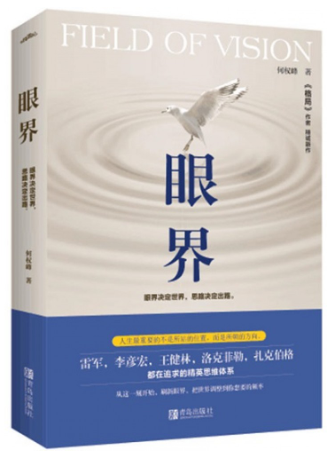
8.8 (Xuanzang's Heart Sutra, Lesson Eight)
Two character words in this section of the Heart Sutra:
無 眼 界 乃 至 無 意 識 界 13
無 無 明 亦 無 無 明 盡 14
乃 至 無 老 死 亦 無 老 死 盡 15
無 苦 集 滅 道 無 智 亦 無 得 以 16
眼界 an gye "realm of eyes"; "field of vision"; literally: "eye" + "realm/element"
乃至 nae ji "and so forth"; literally: "hence; then" + "arrive"
意識 ui shik "mind consciousness"; Skt: mano-vijñāna; literally: "mind" + "consciousness"
無明 mu myeong "ignorance"; literally: "not" + "bright"
老死 no sa "old age and death"; "to die of old age"; literally: "old" + "death"

Slide 10
8.9 (7.16, 4.5) (Xuanzang's Heart Sutra, Lesson Eight)
菩薩 (bosal, 보살) means "Bodhisattva". 薩 only occurs in Chinese as part of 菩薩, or as an abbreviation for it.
菩提 means "Bodhi", it can be pronounced either as "moji" (모지), as in the Mantra, or as "bori" (보리), lines 17 & 23.
There are many (at least 25) two-character words in the Heart Sutra, and several of these appear more than once.
摩訶 ma-ha; "great"; Title
菩提 mo-ji/bo-ri; "Bodhi"; lines Mantra, 17, 23
自在 ja-jae; "self-possessed"; line 1
菩薩 bo-sal; "Bodhisattva"; line 1
照見 jo-gyeon; perceive; line 2
一切 il-che; "all"; lines 3, 26
亦復 yeok-bu; "also"; line 7
故空 shi go; "therefore"; line 10
眼界 an-gye; "realm of eyes"; lines 13
乃至 nae-ji; "and so forth"; lines 13, 25
意識 ui-shik; "mano-vijñāna"; line 13
無明 mu-myeong; "ignorance"; line 14
老死 no-san; "old age and death"; line 15
所得 so-deuk; "what is acquired"; line 17
薩埵 sal-ta; "sattva"; line 17
罣礙 ga-ae; "hindrance"; lines 18, 19
恐怖 gong-po; "terrifying"; line 19
遠離 won-li; "far apart from"; line 20
顚倒 jeon-do; "distorted"; line 20
夢想 mong-sang; "dream"; line 20
究竟 gu-gyeol; "ultimate"; line 20
涅槃 yeol-ban; "nirvana": line 20
無上 mu sang; "utmost"; line 25
能除 neung-je; "take away"; line 26
眞實 jin-shil; "highest truth"; line 27

Slide 11
8.10 (Xuanzang's Heart Sutra, Lesson Eight)
十八界 (Digital Dictionary of Buddhism: http://buddhism-dict.net/cgi-bin/xpr-ddb.pl?q=十八界 )
Basic Meaning: eighteen compositional elements of cognition [of the objective world].
The six sense faculties 六根, their six objects 六塵 and the six consciousnesses 六識.
六根: The six sense organs: eye 眼, ear 耳, nose 鼻, tongue 舌, body 身, and the object-apprehending aspect of the mind 意 (眼根, 耳根, 鼻根, 舌根, 身根, 意根)…. They form the subjective aspect of the eighteen elements 十八界.
Example: 眼 "an" eye
六塵: The five sensory fields and the thought-field. They are the field of form 色塵, field of sound 聲塵, field of odor 香塵, gustatory field 味塵, tactile field 觸塵, and conceptual field 法塵. Mostly synonymous with 六境, except that the usage of the logograph 塵 indicates their defiling character, since, when the six consciousnesses apprehend their objects, the six faculties 六根 become tainted. They are also referred to as the 'external fields' 外塵 and 'six thieves' 六賊.
Example: 色 "saek" color
六識: These are the function of the six organs 六根 of eye 眼, ear 耳, nose 鼻, tongue 舌, skin 身, and reasoning 意 in their apprehension of the six objects of form 色, sound 聲, smell 香, taste 味, touch 觸 and symbols 法, attained in the acts of seeing 見, hearing 聞, smelling 嗅, tasting 味, touching 觸 and knowing 知. In Yogâcāra Buddhism, these are the first six of the eight consciousnesses 八識.
Example: 眼界 an gye "realm of eyes"

Slide 12
8.11 (Xuanzang's Heart Sutra, Lesson Eight)
四 弘 誓 願
衆 生 無 邊 誓 願 度
煩 惱 無 盡 誓 願 斷
法 門 無 量 誓 願 學
佛 道 無 上 誓 願 成
聞 鐘 聲 煩 惱 斷
智 慧 長 菩 提 生 離 地 獄
出 三 界 願 成 佛
度 衆 生
破 地 獄 眞 言
唵 伽 囉 帝 耶 娑 婆 訶
延 命 十 句 觀 音 經
觀 世 音
南 無 佛
與 佛 有 因
與 佛 有 緣
佛 法 僧 緣
常 樂 我 淨
朝 念 觀 世 音
暮 念 觀 世 音
念 念 從 心 起
念 念 不 離 心
Four
Great
Vows
生 also in Heart Sutra
願 also in Evening Bell Chant
Kannon Sutra
觀 also in
Heart Sutra
佛
Guess which character is in all three??
Evening Bell Chant
聲 also in Heart Sutra
煩 also in Four Vows

Slide 13
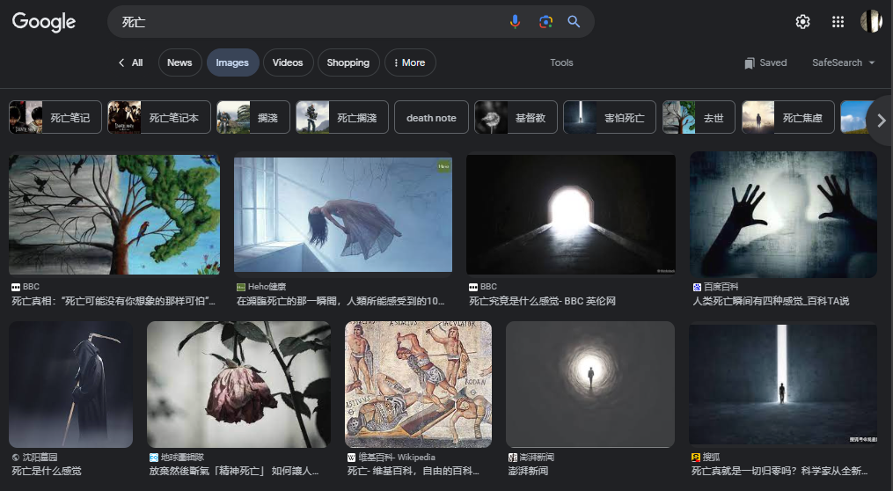
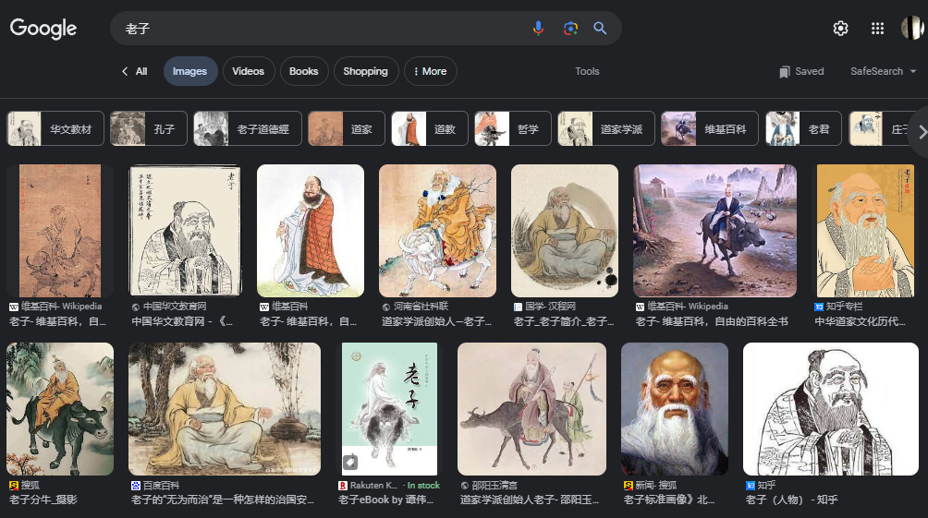
8.12 (Xuanzang's Heart Sutra, Lesson Eight)
老子 (literally: "old" + "master"
lǎo zǐ (Mandarin)
no ja (Korean)
lão tử (Vietnamese)
rō shi (Japanese)
死亡 (literally: "death" + "die")
sǐ wáng (Mandarin)
sa mang (Korean)
tử vong (Vietnamese)
shi bō (Japanese)
https://www.google.com/search?q=死亡&tbm=isch
https://www.google.com/search?q=老子&tbm=isch

Slide 14
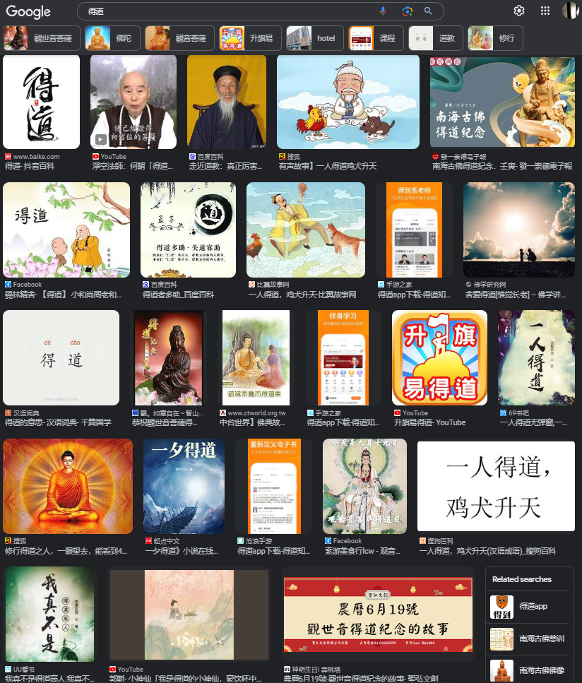
8.13 (Xuanzang's Heart Sutra, Lesson Eight)
得道 (literally: "attain" + "Dao")
dé dào
deuk do
được dạo
hanbook.com :
1 v. uphold justice
dé dào duō zhù
得道多助
A just cause enjoys abundant support while an unjust cause finds little support.
2 v. achieve enlightenment
yù fó fàng wú liàng guāng míng ér dé dào
遇佛放无量光明而得道
achieve enlightenment because of the encounter with Buddha unleashing unlimited light
https://www.hanbook.com/chinese-dictionary/words/de2-dao4-uphold-justice-achieve-enlightenment

Slide 15
8.14 (Xuanzang's Heart Sutra, Lesson Eight)
智 (ji) basic meaning: to know
Cognition, awareness (Skt. jñāna; Tib. shes pa, ye shes). The function of the intellect. Intelligence. Although in pre-Buddhist literary Chinese the primary connotation of this term is 'wisdom,' (as distinguished from 'knowledge' 知) in the translation of Abhidharma, Yogācāra, and Tathāgatagarbha texts from Sanskrit into Chinese, it was commonly used to translate jñāna, thus cognition, understanding, awareness. It is, nonetheless, also seen used to translate prajñā, as in 智度, as well as alone. The tendency in later East Asian works (Chan, Huayan, and Tiantai) is to move more in the direction of the sense of wisdom.
Buddhist discourse commonly bifurcates cognition into two general types: (1) pure, nondiscriminating awareness (such as 正體智), and (2) the discriminating cognition necessary for mundane functionality, which can have either the negative connotation of deluded mundane discrimination or the accurate discrimination used by bodhisattvas to teach others. See 二智. Prajñā is transliterated as 若那 and jñāna is transliterated as 闍那. See also 一智 (Skt. dhī, buddhi, abhijñā, mati).
知 (ji) basic meaning: to know
● To understand; to cognize, to be aware of. The Sanskrit root is vid, hence vidyā, knowledge; the Vedas, etc. Generally speaking 知 is used to translate vijñā (to know), and 智 renders vijñāna or prajñā, wisdom arising from perception or knowing. But this distinction is not always uniform, especially in the rendering of Abhidharma and Yogâcāra texts (Skt. prajānāti, jñāna; Tib. mkhyen pa; rab tu shes pa). [Charles Muller; source(s): Nakamura, Soothill, Hirakawa, YBh-Ind]
● Knowledge, awareness, consciousness. [Charles Muller]
● Wisdom. [Charles Muller]
● [What has been] perceived. (Skt. vijñāta; Tib. bye brag phyed pa). [Charles Muller; source(s): Stephen Hodge]
Digital Dictionary of Buddhism entries:
智: http://www.buddhism-dict.net/cgi-bin/xpr-ddb.pl?q=智
知: http://www.buddhism-dict.net/cgi-bin/xpr-ddb.pl?q=知

Slide 16
8.15 (Xuanzang's Heart Sutra, Lesson Eight)
A tale of two transliterations:
無 眼 界 乃 至 無 意 識 界 13
HG: 무 안 계 내 지 무 의 삭 계
RR: mu an gye nae ji mu ui shik gye
IR: mu- an- gye nae- ji mu- ui- shik- kye
English: no realm of eyes and so forth until no realm of mind consciousness
無 無 明 亦 無 無 明 盡 14
HG 무 무 명 역 무 무 명 진
RR: mu mu myeong yoek mu mu myeong jin
IR: mu- mu- myong yong mu- mu- myong- jin
English: no ignorance and also no extinction of it
HG: Hangeul
RR: Revised Romanization
IR: Informal Romanization

Slide 17
8.16 (Xuanzang's Heart Sutra, Lesson Eight)
(transliterations, continued ….)
乃 至 無 老 死 亦 無 老 死 盡 15
HG: 내 지 무 누 사 역 무 누 사 진
RR: nae ji mu no sa yeok mu no sa jin
IR: nae- ji mu- no- sa yong- mu- no- sa- jin
and so forth until no old age and death and also no extinction of them
無 苦 集 滅 道 無 智 亦 無 得 以 16
HG: 무 구 집 멸 구 무 지 역 무 극 이
RR: mu go jib myeol do mu ji yeok mu deuk i
IR: mu go- jim- myol- to mu- ji yong- mu- dug- i
no suffering, origination, stopping, path, cognition, also no attainment with
The "Revised Romanization" (RR) is now the standard, and has been since 2000. The previous standard had been the "McCune–Reischauer romanization", which made heavy use of apostrophes and diacritical marks. For example: using RR 연구 is transliterated as yeon gu, whereas in the older system it was yŏn'gu.

Slide 18
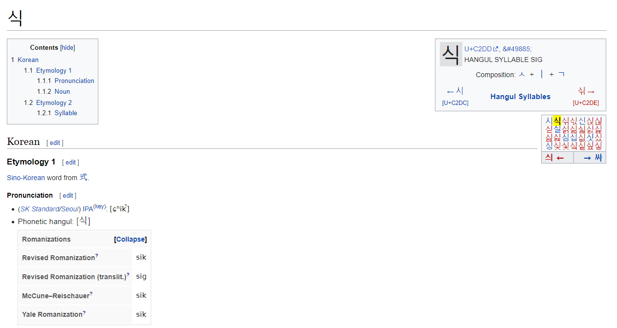
8.17 (Xuanzang's Heart Sutra, Lesson Eight)
(transliterations, continued ….)
This is a screen capture from the Wiktionary entry for 식 (https://en.wiktionary.org/wiki/식 ). Note that when an initial "s" sound is followed by the vowel "i" it is pronounced more like "sh" than "s". But the RR transliteration always uses "s" anyway. Also note that the final consonant is in this word is not "released", which is one of the things that makes learning how to pronounce Korean "interesting".

Slide 19
8.18 (Xuanzang's Heart Sutra, Lesson Eight)
1. 广 gwang (광); vast, wide
2. 林 rim (림); forest
3. 手 su (수); hand
4. 丶 ju (주); ancient punctuation mark, alt. form of 主
5. 厂 han (한); cliff; alternative form of 广
6. 木 mog (목); tree; wood
7. 言 eon (언); words, speech, say
8. 可 ga (가); can; be able to; emphasis; permit; v. can-be...-ed
9. 亠 du (두); lid, cap, cover; head
10. 二 i (이); 2, two
11. 口 gu (구); mouth
12. 一 il (일); 1, one
13. 丁 jeong (정); fourth of the heavenly forms; fourth; robust
14. 亅 gweol (궐); hook
15. 舟 ju (주); boat, ship
16. 殳 su (수); tool; weapon; lance
17. 丿 byeol (별); left falling stroke (撇)
18. 冂 gyeong (경); wide; upside-down box; suburbs; city outskirts
19. ⺀ bing (빙); ice; variant form of ⼎Radical of: 冰
20. 几 gwe (궤); stool, chair; bench, small table
21. 又 u (우); again; once more; also
22. 艹 cho (초); grass; radical of: 艸
23. 右 u (우); right; west
24. 氵 su (수); water; river; liquid; radical of: 水
25. 皮 pi (피); skin, hide, surface
26. 冰 bing (빙); ice; radical forms: ⼎, ⺀
27. 冫 bing (빙); ice; radical of: 冰
28. 水 su (수); water; radical form: 氵
29. 永 yeong (영); perpetual, eternal, forever
30. 摩 Kr: ma (마); phonetic; rub, grind
31. 訶 ha/ga (하/가); phonetic; blame, scold
32. 般 ban (반 ); phon.; carry; all; sort
33. 若 ya (야); phonetic; as if, like
34. 波 ba/pa (바/ 파) ; phonetic; wave, breaker
35. 羅 ra (라); phonetic; net; gauze
36. 蜜 mil (밀); phonetic; honey, sweet
37. 多 da (다); many, much, far more
38. 心 shim (심); heart/mind; radical form: 忄
39. 經 gyeong (경); sutra; weave; pass, passing
40. 罒 mang (망); net; web; internet; radical of: 网
41. 糹 sil (실); silk; radical of: 糸
42. 隹 chu (추); small bird, short-tailed bird
43. 幺 yo (요); tiny; small; minute
44. 亻 in (인); person; left radical of: 人
45. 主 ju (주); owner; master, lord; host;
46. 王 wang (왕); king; monarch; jade (alternate form of 玉)
47. 宀 myeon (면); roof
48. 必 pil (필); surely; most certainly; always; must
49. 虫 chung (충); insect, bug; snake
50. 冖 myeok (멱); cover; lid; crown

Slide 20
8.19 (Xuanzang's Heart Sutra, Lesson Eight)
51. 中 jung (중); among/in; midst/in the midst
52. ㇀ rising stroke, 提, for example the second stroke in 冰
53. 夕 seok (석); night, dusk
54. 巠 gyeong (경); flowing water
55. 巛 cheon (천); river, stream
56. 工 gong (공); work; worker; labor
57. 扌 su (수); hand; radical of: 手
58. 曷 gal (갈); why; what; where; when
59. 曰 wal (왈); to say
60. 匃 gae (개); beggar; crouch
61. 囗 wi (위); enclosure; to surround; encircle
62. 勹 po (포); wrap
63. 人 in (인); person, human being; radical form: 亻
64. 揭 a/ge (아/게); phonetic; uncover, reveal
65. 㡭 gye (계); continue; maintain; carry on
66. 諦 je (제); emperor
67. 僧 seung (승); phonetic; monk, sangha
68. 菩 mo/bo (모/보); Bodhisattva; phonetic
69. 提 ji/ri (지/리); carry, lift; put forward
70. 娑 sa (사); phonetic; whirling, dancing
71. 婆 ba (바); phonetic; grandmother
72. 帝 je (제); emperor
73. 立 rib (립); stand; set up; lay down; establish; draw up
74. 巾 geon (건); traditional head covering, kerchief
75. 丷 pal (팔); eight, 8; component variant of 八
76. 曾 jeung (증); modifier indicating past tense or a further increase
77. 咅 pu (부); spit out
78. 是 shi (시); to be; yes
79. 日 il (일); sun; day; daily
80. 疋 so (소); bolt of cloth
81. 少 so (소); few, little, young
82. 女 yeo (여); female
83. 觀 guan (관); perceive
84. 自 ja (자); oneself; one's own
85. 在 jae (재); be; at; live
86. 雚 gwan (관); heron
87. 見 gyeon (견); see; meet; be visible
88. 目 mok (목); eye; item; section; list; catalogue; table of contents
89. 儿 in (인); child; person
90. 土 to (토); earth, soil, land
91. 薩 sal (살); phonetic
92. 行 haeng (행); practice, austerity, impulse; go, tr
93. 深 shim (심); deep
94. 時 shi (시); time/when
95. 照 jo (조); illuminate
96. 五 o (오); 5, five
97. 蘊 on (온); skandha
98. 皆 gae (개); all
99. 空 gong (공); sunyata; emptiness; space; sky
100. 阝 bu (부); mound; abundant; city;town

Slide 21
8.20 (Xuanzang's Heart Sutra, Lesson Eight)
101. 产 san (산); property; give birth
102. 生 saeng (생); give birth; live, be alive; nature
103. 彳 cheok (척); step; walk slowly
104. 亍 chok/ma (촉/마); to step; walk slowly; step with ri
105. 罙 shim (심); far
106. 寺 sa (사); temple; monastery; government cour
107. 寸 chon (촌); short; unit of measure; inch
108. 昭 jo (조); bright; luminous; illustrious
109. 灬 hua (화); fire
110. 火 hua (화); fire; urgent; ammunition; fiery or
111. 召 jo (조); imperial decree; to summon
112. 刀 do (도); knife; blade; single-edged sword
113. 縕 on (온); hemp
114. 囚 su (수); prisoner
115. 皿 myeong (명); dish; vessel; plate
116. 比 bi (비); compare, contrast
117. 白 baek (백); white; snowy; pure; bright; empty
118. 穴 hyeol (혈); hole
119. 八 pal (팔); eight (8)
120. 入 ip (입); enter
121. 度 do (도); go-over; ferry across; save (sentient beings)
122. 切 che/jeol (체/절); close to; eager, earnest, sincere;
123. 苦 go (고); suffering; bitter
124. 厄 aek (액); misfortune/distress
125. 舍 sa (사); phonetic/lodging
126. 利 li (리); phonetic; sharp; profit, benefit, advantage
127. 子 ja (자); master/son
128. 色 saek (색); form/color
129. 不 bur/bu (불/부); not
130. 異 i (이); different
131. 即 jeug (즉); very close to, agree, conform, sam
132. 廿 ip (입); twenty, 20
133. 七 chil (칠); 7, seven
134. 古 go (고); the past; ancient times; old
135. 十 shib (십); 10, ten
136. 㔾 jeol (절); variant form of 卩, xiān, seal
137. 舌 seol (설); tougue
138. 千 cheon (천); thousand
139. 禾 hwa (화); grain; cereal; rice plant
140. 刂 do (도); blade
141. 了 yo (요); perfective aspect; indicates change
142. ⺈ do (도); knife; blade
143. 巴 pa (파); a huge snake that can swallow an elephant
144. 田 jeon (전); farmland; field
145. 共 gong (공); together; adv. jointly; as a group
146. 卄 ip (입); twenty, 20, variant form of 廿
147. 厶 sa (사); self, private, secret
148. 卩 jeol (절); seal
149. 互 ho (호); mutual
150. 百 baek (백); hundred

Slide 22
8.21 (Xuanzang's Heart Sutra, Lesson Eight)
151. 受 su (수); feeling; to receive
152. 想 sang (상); perception; to think; reckon
153. 識 shik (식); consciousness; to know; to realise
154. 亦 yeok (역); also; again
155. 復 bu (부); to go and return; to return; to re
156. 如 yeo (여); as; as if; such as
157. 諸 je (제); all
158. 法 beop (법); dharma; thought; thing
159. 相 sang (상); characteristic, attribute, mark;
160. 滅 myeol (멸); extinguish; destroy
161. 垢 gu (구); impure, tainted
162. 淨 jeong (정); pure
163. 爫 jo (조); nail/claw; dispute, fight, contend
164. 戠 shi (시); sword
165. 音 eum (음); sound; noise; note (of musical scale)
166. 戈 gwa (과); dagger-ax/halberd, spear
167. 弋 ik (익); to shoot; arrow
168. 复 bok (복); repeat; double; overlap
169. 夂 chi (치); to go; walk slowly
170. 者 ja (자); this; used at end of command
171. 耂 no (노); old
172. 去 geo (거); to go; to go to (a place);
173. 烕 myeol (멸); extinguish;destroy
174. 戌 sul (술); dog (zodiac); 11th of the 12 earthly branches
175. 后 hu (후); ruler; queen, king; empress, emperor
176. 爭 jaeng (쟁); fight; contend; strive
177. 彐 gye (계); snout;pig-head;pig-snout
178. 今 geum (금); now; at present; this
179. 从 jong (종); follow; from
180. 坐 jwa (좌); to sit; to take a seat; to take (a
181. 增 jeung (증) increase
182. 減 gam (감) decrease
183. 故 go (고) therefore
184. 無 mu (무) no
185. 眼 an (안) eye
186. 耳 i (이) ear
187. 鼻 bi (비) nose
188. 身 shin (신) body
189. 意 ui (의) mind
190. 聲 seong (성) sound
191. 香 hyang (힝) smell
192. 味 mi (미) taste
193. 觸 chok (촉) touch
194. 咸 ham (함) all
195. 攵 bok (복) hit
196. 卌 ship (십) forty
197. 川 cheon (천) river
198. 艮 gan (간) stopping
199. 畀 bi (비) give
200. 丌 gi (기) table

Slide 23
8.22 (Xuanzang's Heart Sutra, Lesson Eight)
201. 殸 seong (성) enemy
202. 声 seong (성) voice
203. 士 sa (사) scholar
204. 未 mi (미) have not
205. 角 gak (각) horn
206. 蜀 chok (촉) Sichuan
207. 用 yong (용) to use
208. 月 wol (울) moon
209. 念 yeom (염) attention
210. 金 geum (금) gold
211. 界 gye (계) realm
212. 乃 nae (내) therefore
213. 至 ji (지) arrive
214. 明 myeong (명) bright
215. 盡 jin (진) end
216. 老 no (노) old
217. 死 sa (사) death
218. 集 jib (집) origination
219. 道 do (도) Dao
220. 智 ji (지) to know
221. 得 deuk (득) obtain
222. 以 i (이) with; therefore
223. 介 gae (개) between
224. 匕 bi (비) spoon; dagger
225. 歹 dae (대) bad, evil
226. 首 su (수) best; chief
227. 辶 chak (착) walk
228. 知 ji (지) to know
229. 矢 si (시) arrow
230. 天 cheon (천) heaven
231. 㝵 deuk (득) obtain
232. 旦 dan (단) dawn
233. 山 san (산) mountain
234. 亼 jib (집) gather
235. 命 myeong (명) life
236. 聿 yul (율) brush
237. 唐 dang (당) Tang
238. 門 mun (문) gate
239. 屮 jwa (좌) left hand
240. 出 chul (출) go out
241. 所 so (소) "that which is"
242. 埵 ta (타) phonetic; hard soil
243. 依 ui (의) rely on
244. 罣 ga (가) hinder; entangle; block
245. 礙 ae (애) hinder; obstruct; deter
246. 有 yu (유) have
247. 恐 gong (공) afraid; fear
248. 怖 po (포) terror; terrified
249. 戶 ho (호) household; door
250. 斤 geun (근) axe; hatchet; unit of weight

Slide 24
8.23 (Xuanzang's Heart Sutra, Lesson Eight)
垂 geun (근)
衣
表
石
疑
予
巩
凡
忄
布 po (포)
近
休
紅
床
金
只
四
弓
弘
弗 bur (불)
遠
離
顚
倒
夢
究
竟
涅
槃
三 sam (삼)
袁
世
佛
离
凶
禸
凵
眞
頁
到 do (도)
九
圼
仙
高
送
字
森
慈
本
悲 bi (비)

